Slide 1
Types and versions in Roman art: some contexts

Slide 2
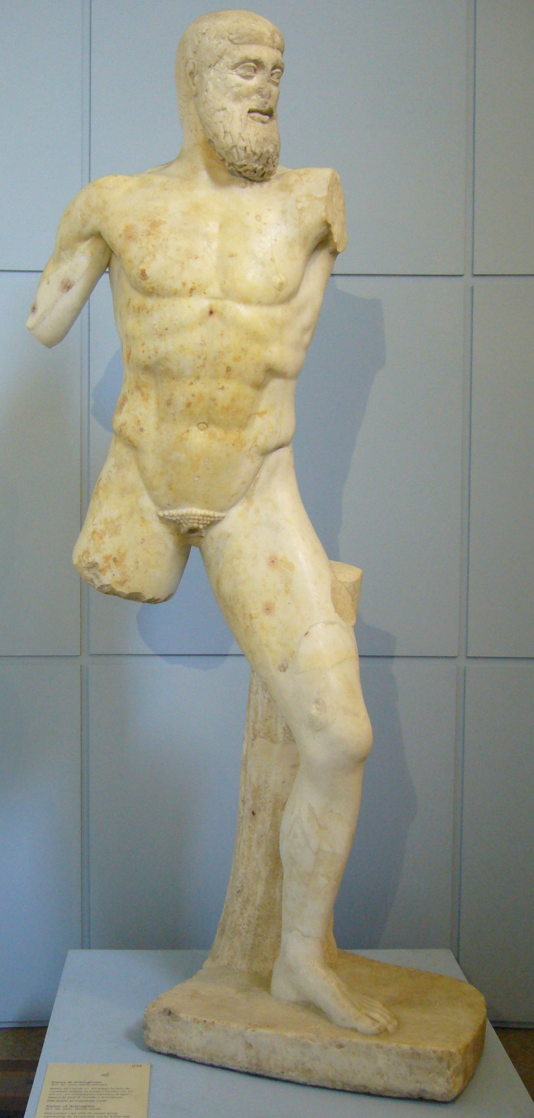
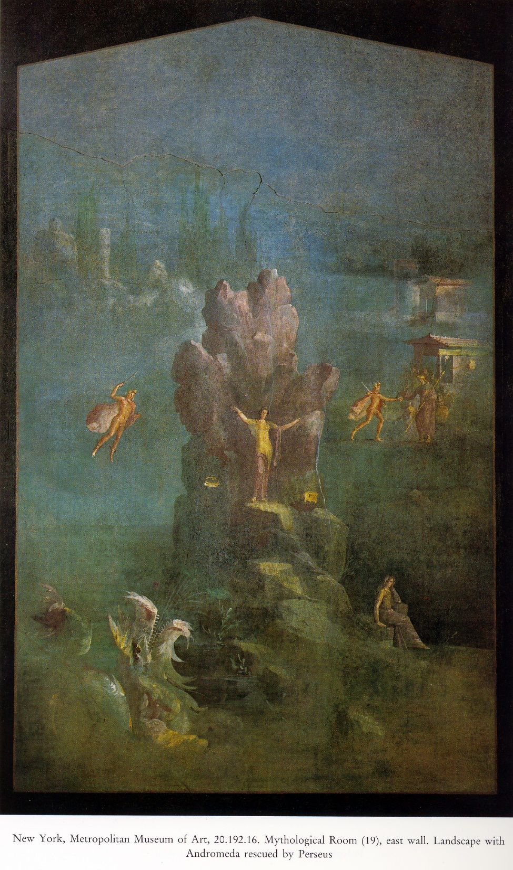
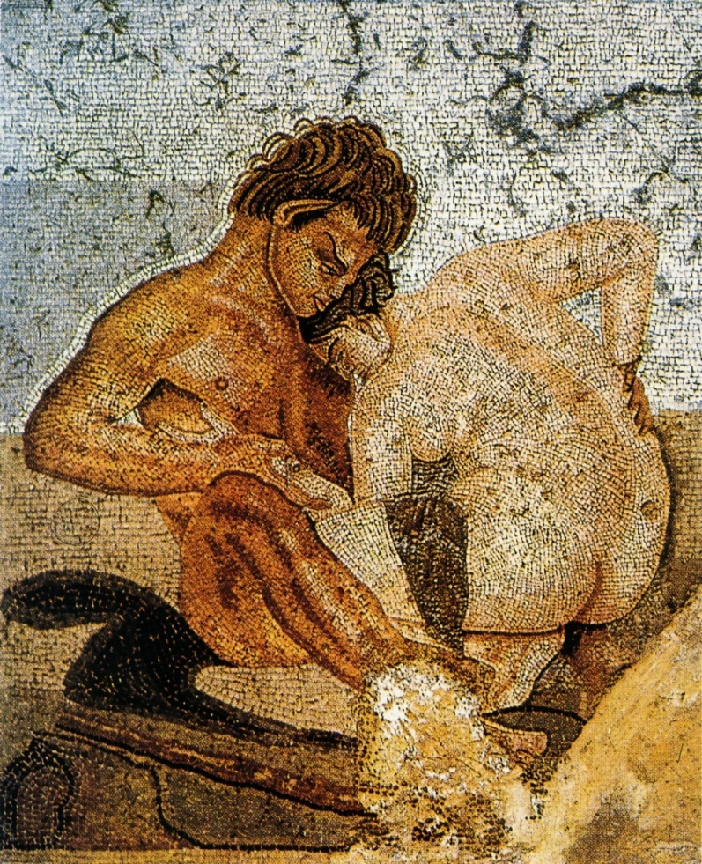
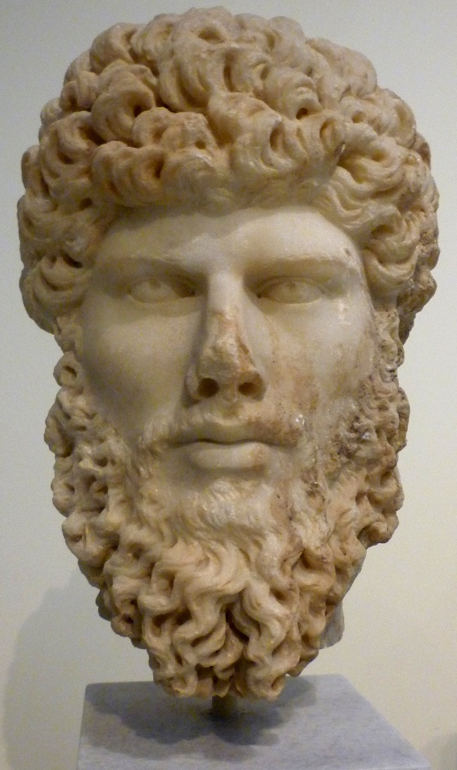
T Y P E S A N D V E R S I O N S I N R O M A N A R T :
S O M E C O N T E X T S

Slide 3
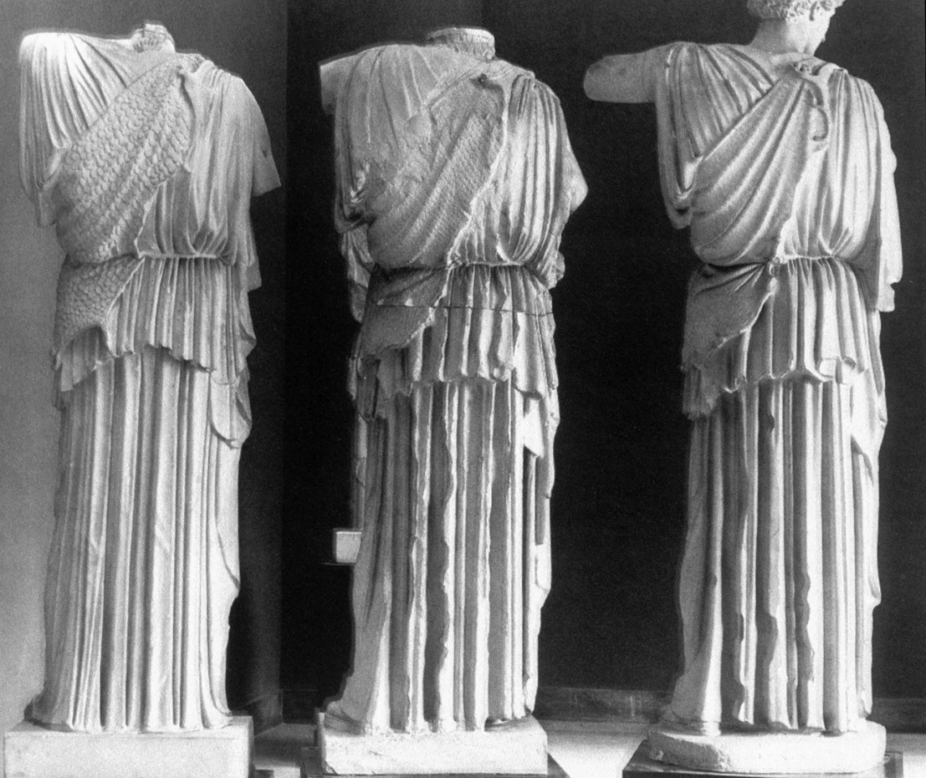
MORE ALIKE,
or
MORE
DIFFERENT?
THREE ATHENAS OF ‘LEMNIA’ TYPE

Slide 4
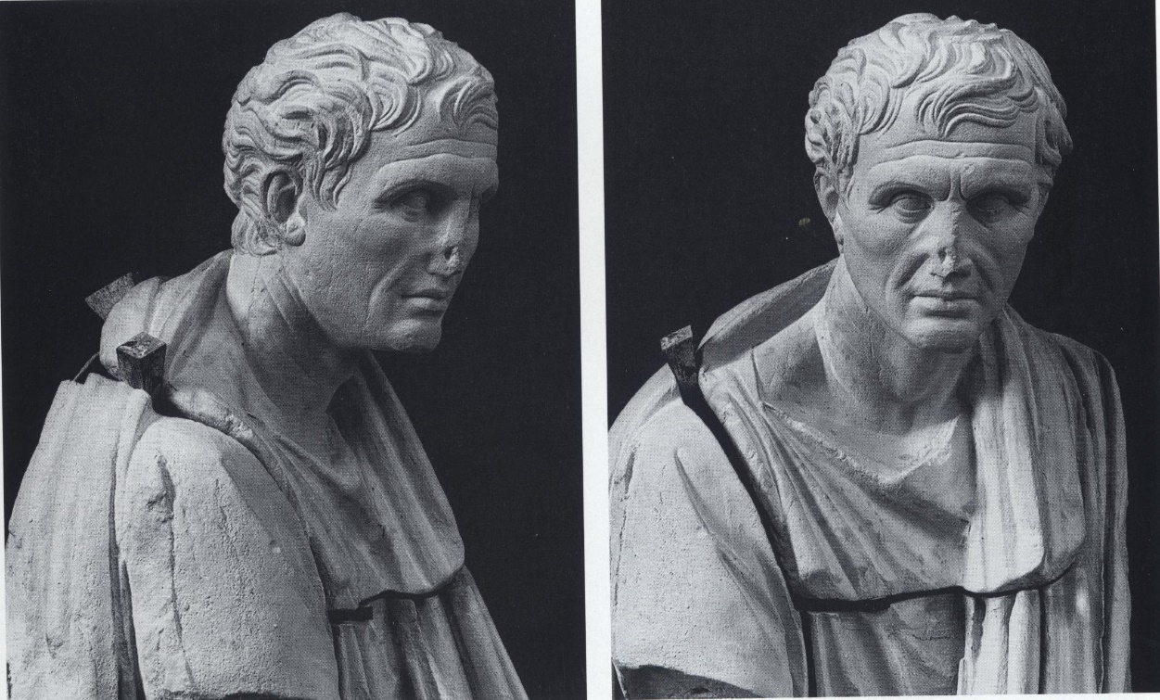
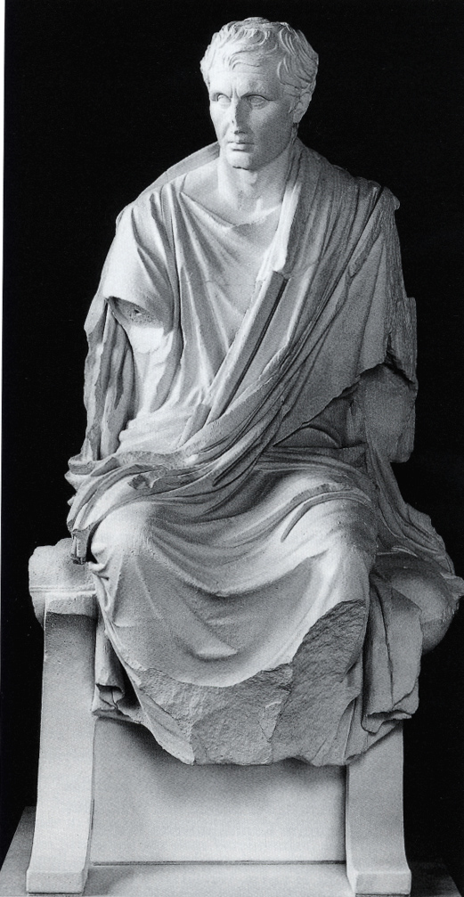
VENICE
VENICE & NAPLES:
Reconstruction, K. Fittschen

Slide 5
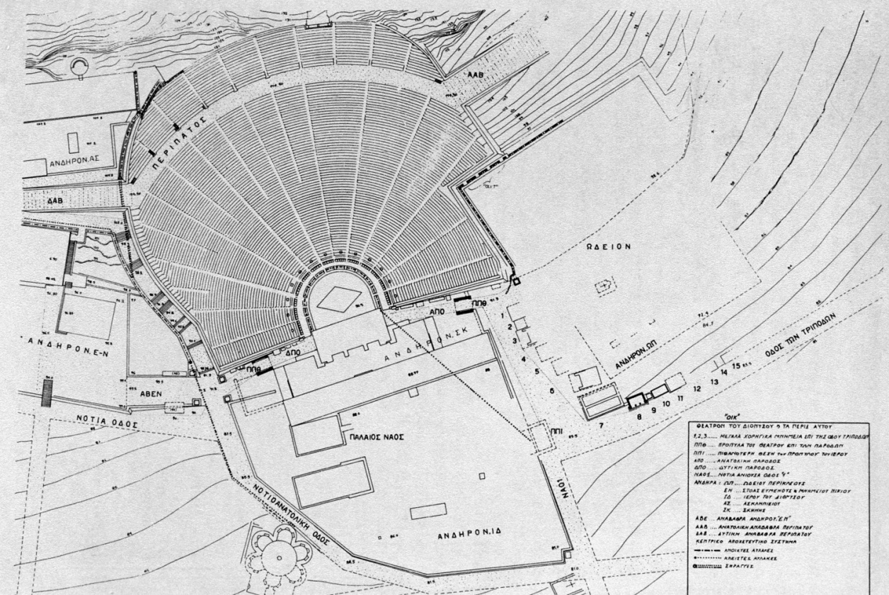
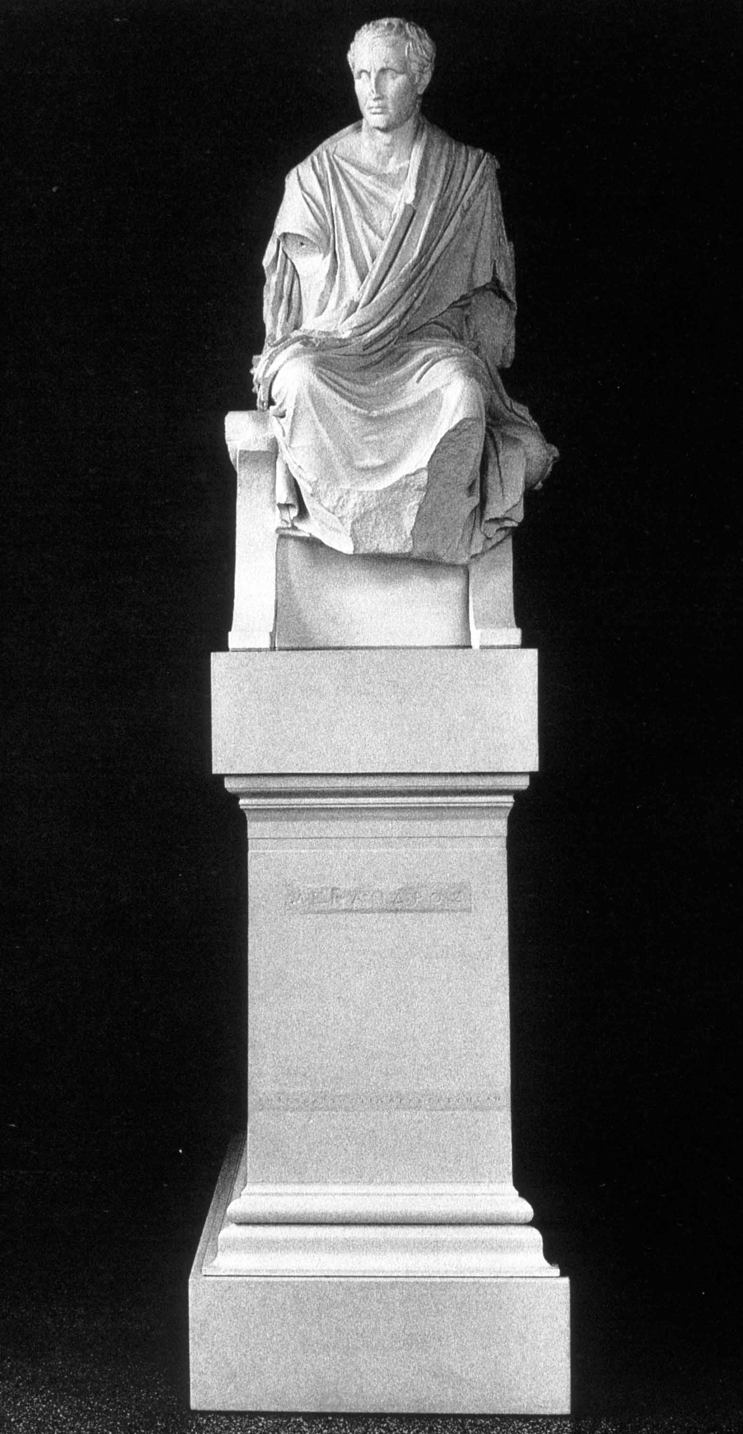
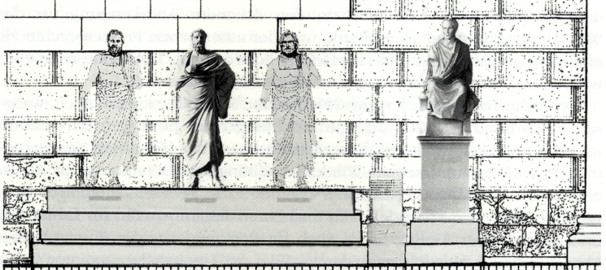
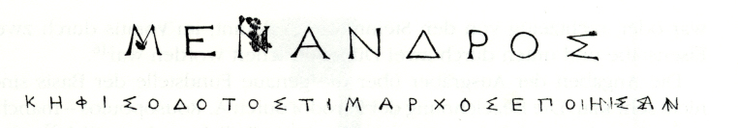
Theatre of Dionysus, Athens

Slide 6
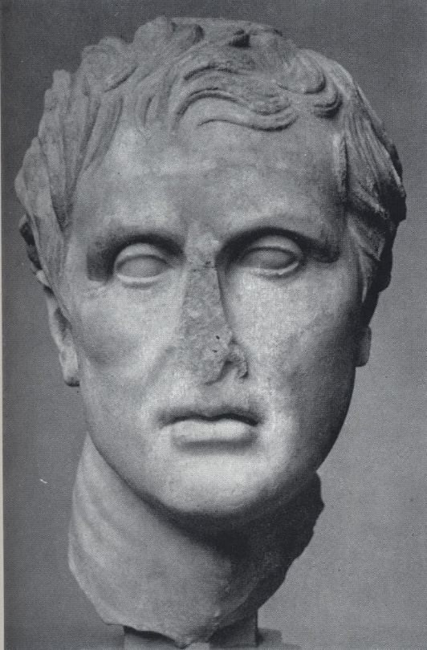
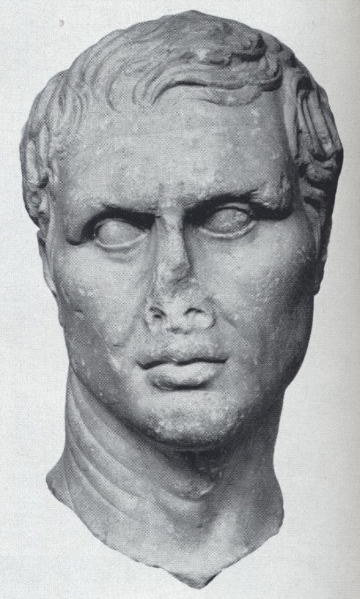
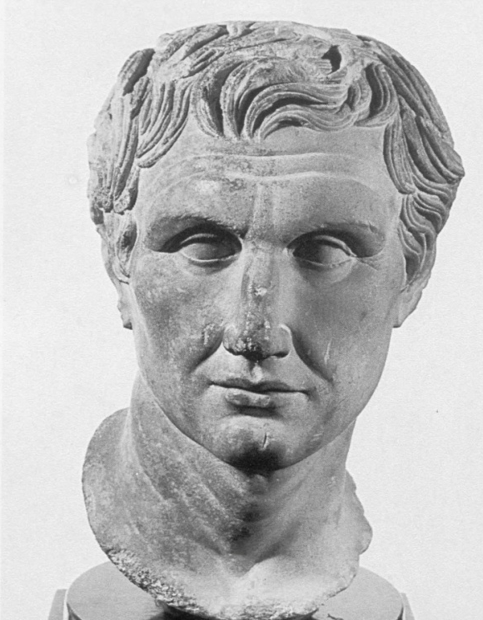
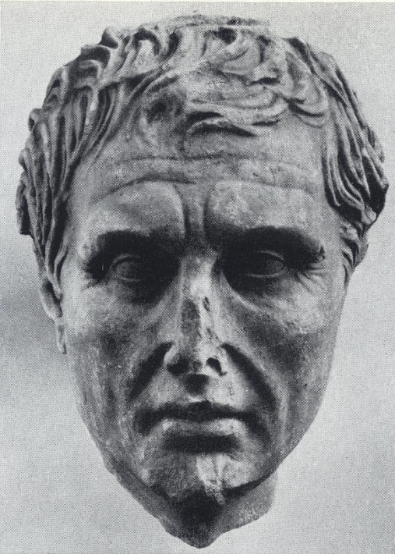
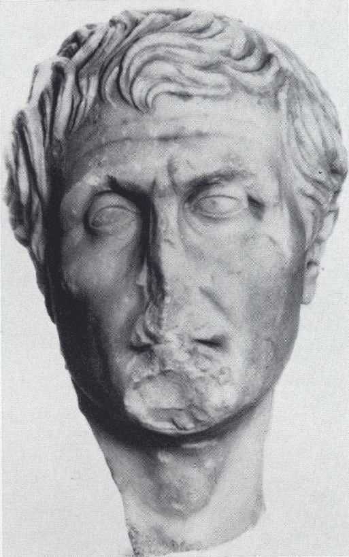
VENICE
COPENHAGEN
PAESTUM
DUMBARTON OAKS
CORFU
RHODES

Slide 7
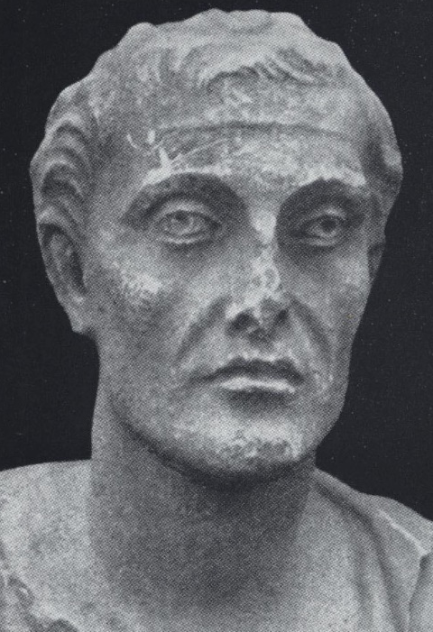
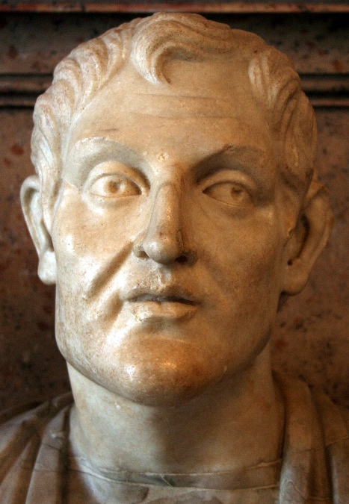
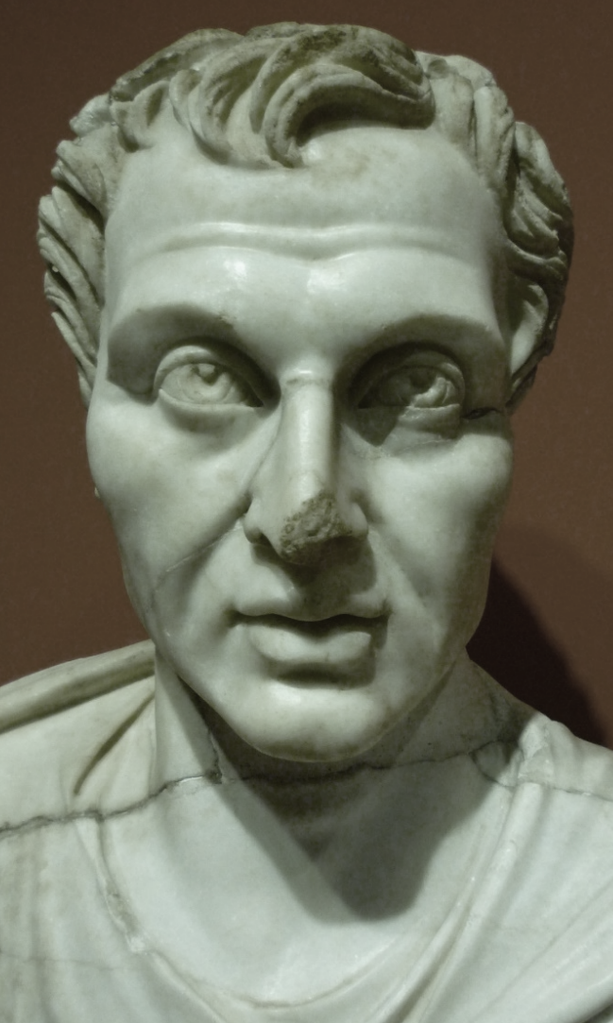
KONYA
CAPITOLINE
EPHESOS

Slide 8
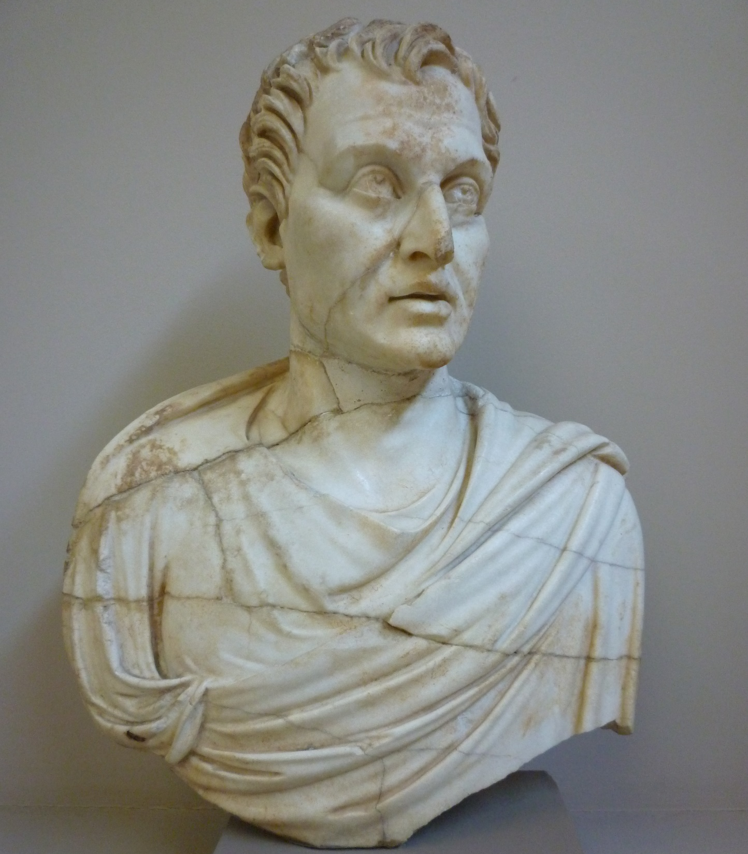
EPHESOS

Slide 9
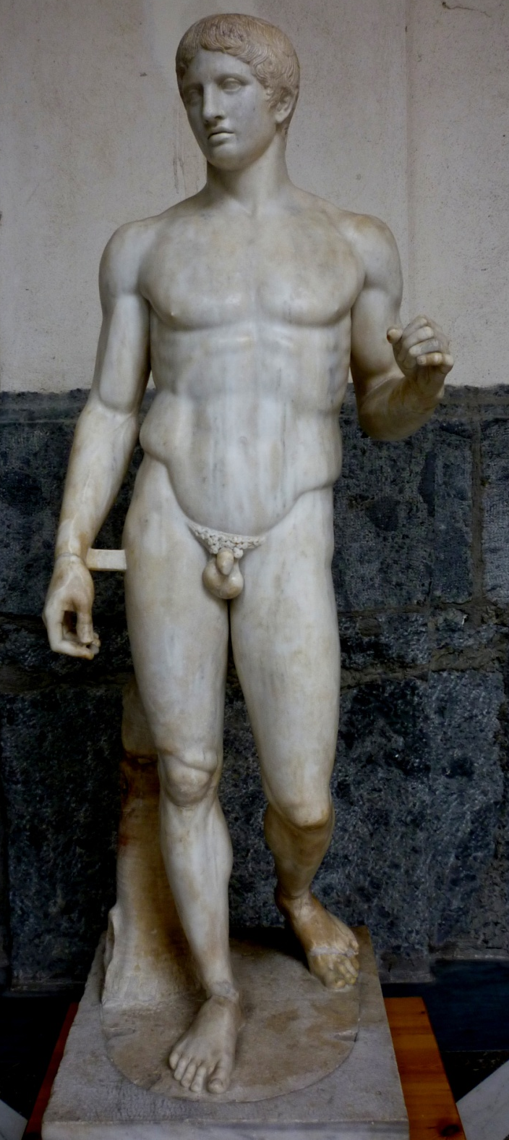
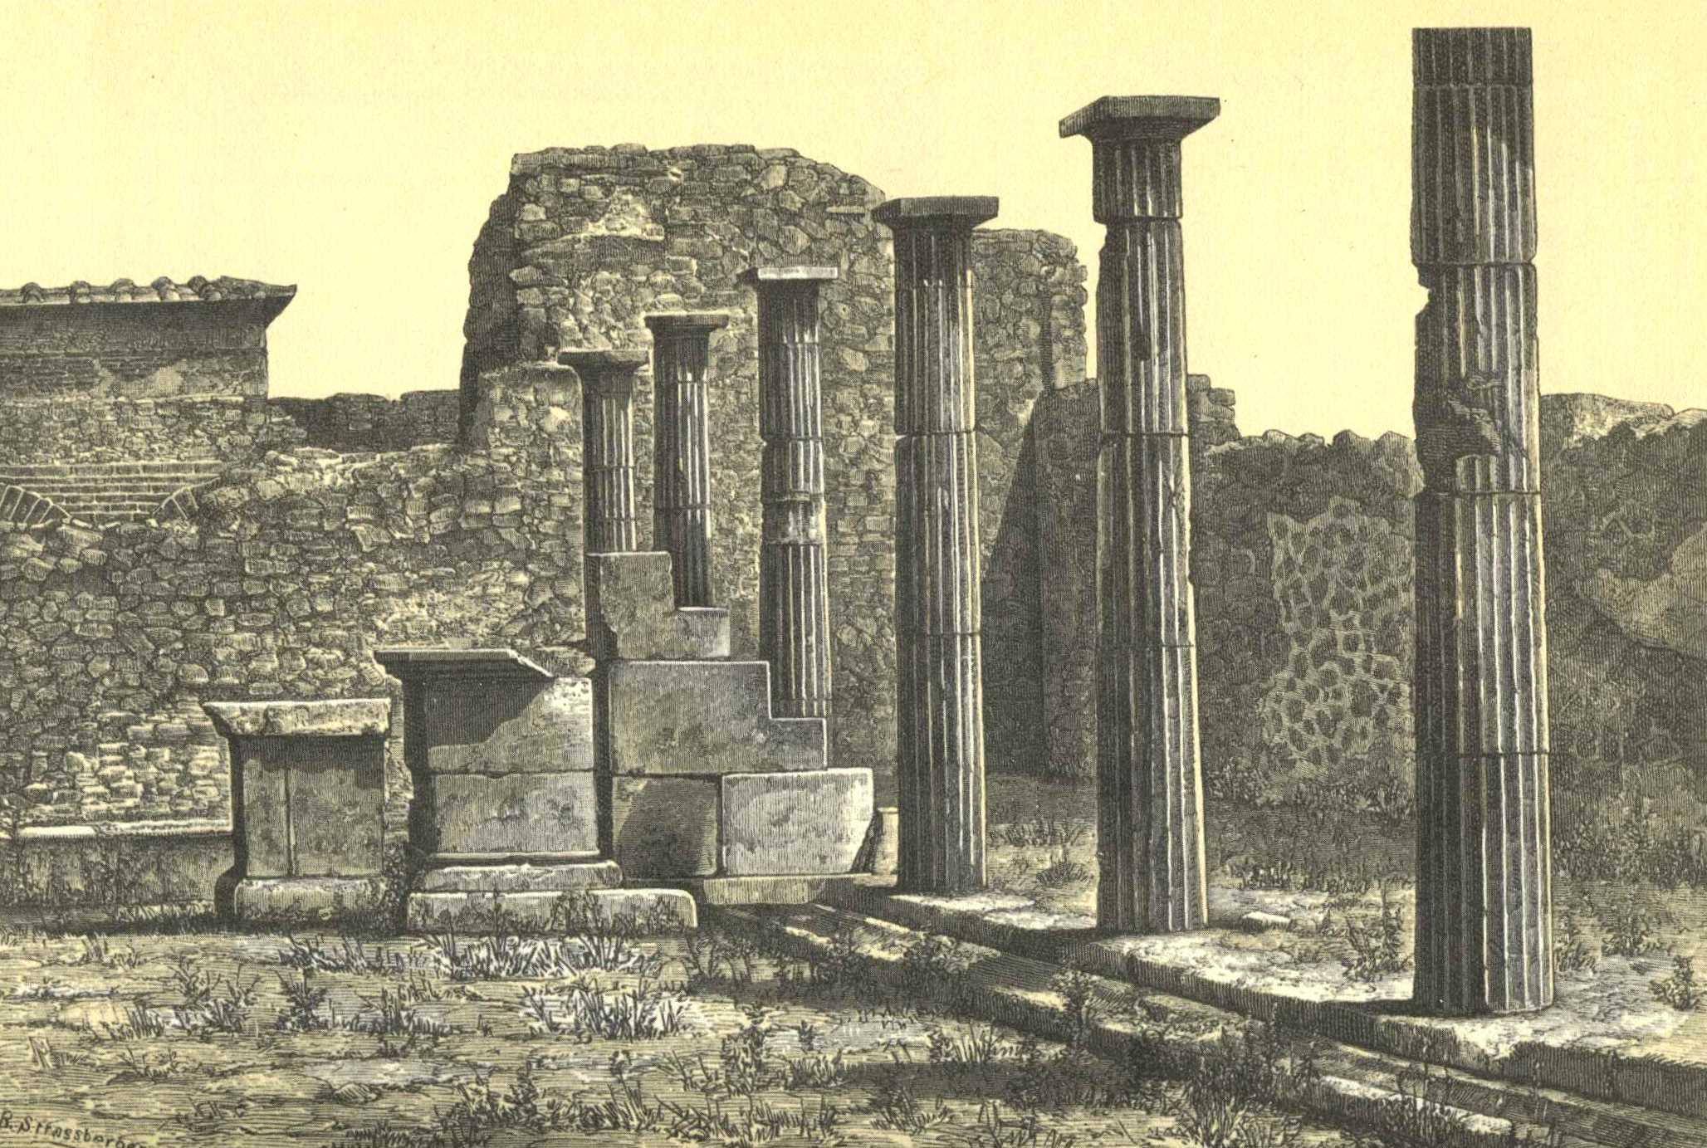
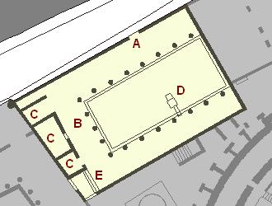
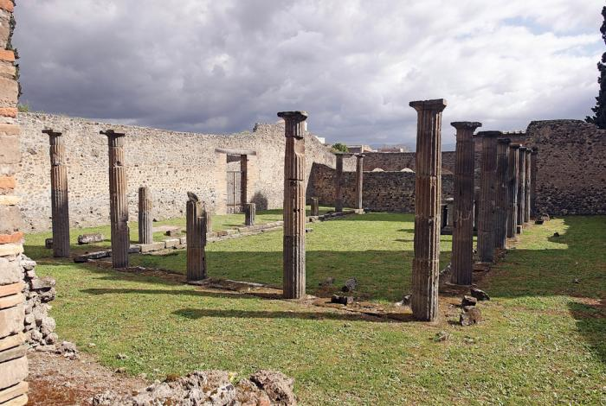
POMPEII (Naples)
‘SAMNITE PALAESTRA’, POMPEII

Slide 10
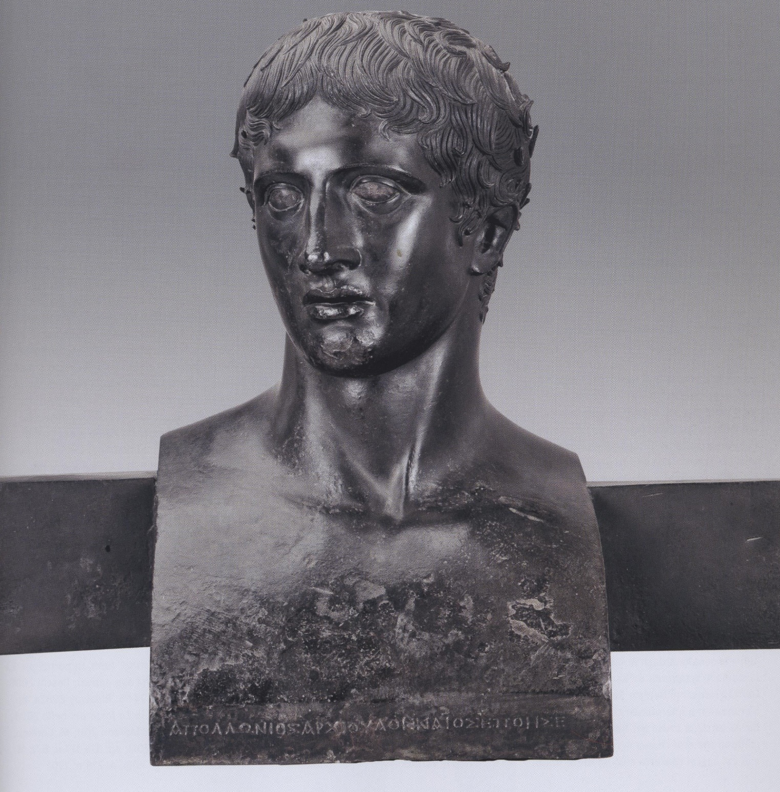
HERCULANEUM

Slide 11
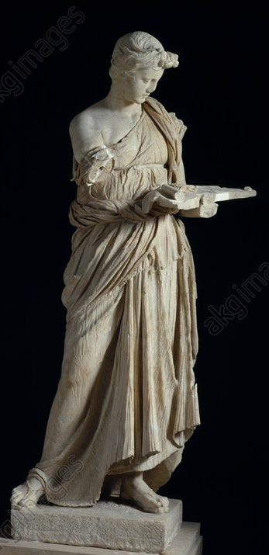
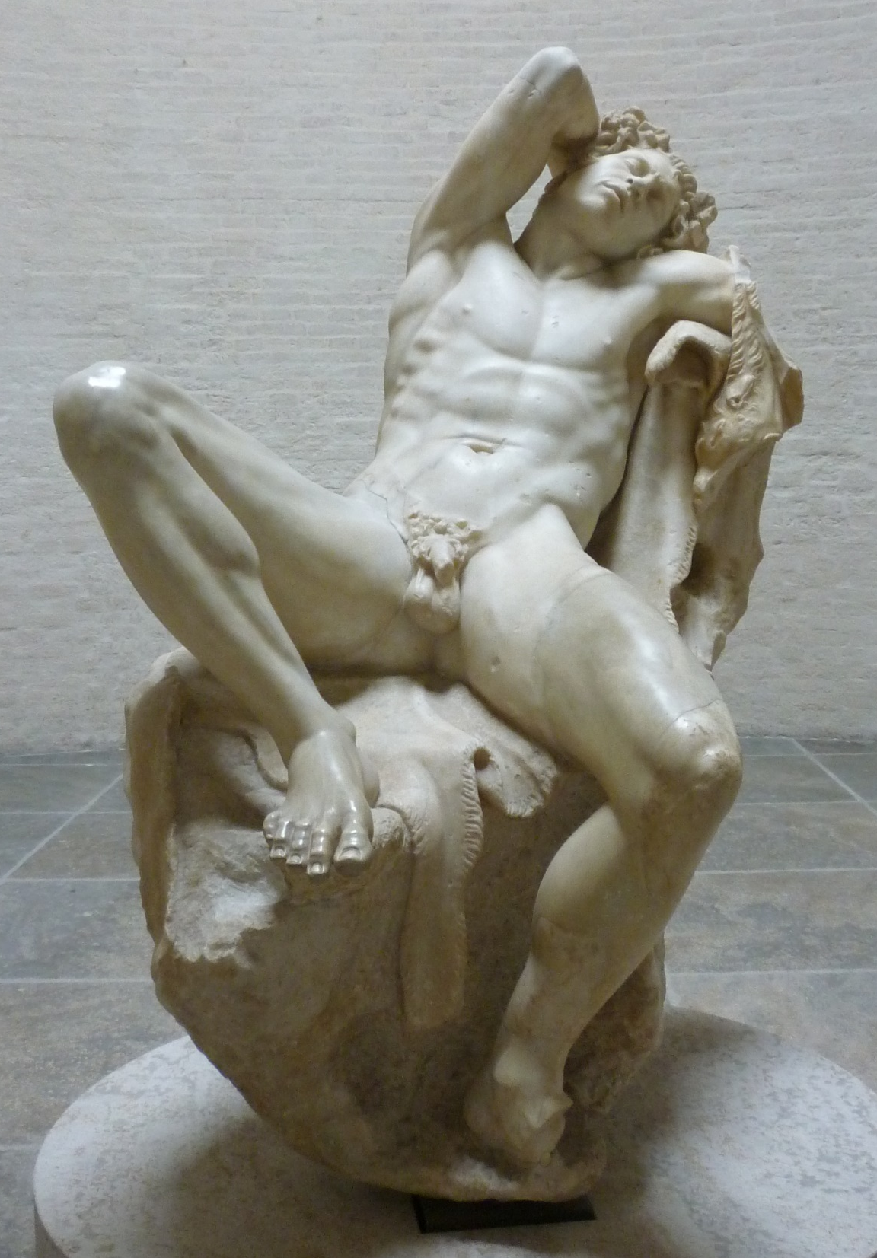
ANTIUM (P-Massimo)
ROME (Munich)

Slide 12
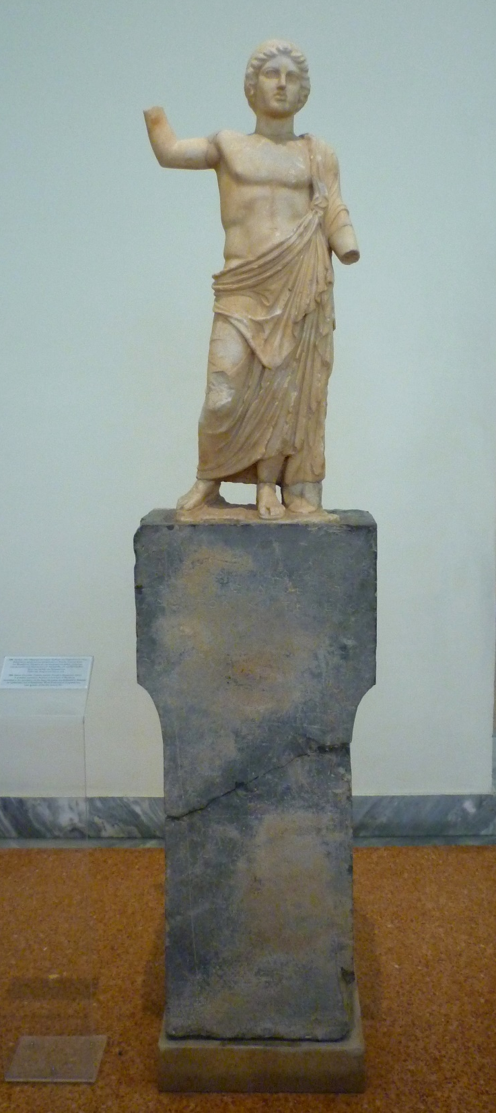
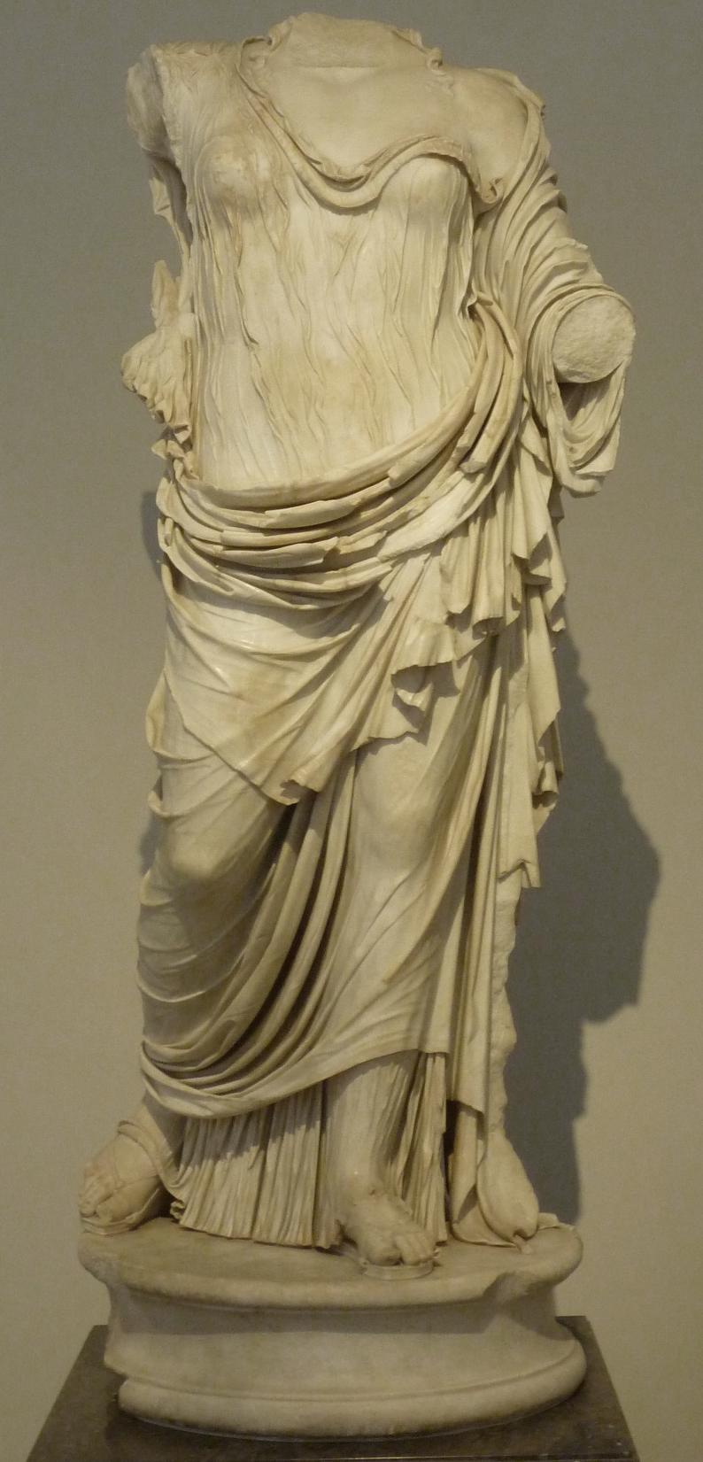
RHAMNOUS
PALATINE

Slide 13
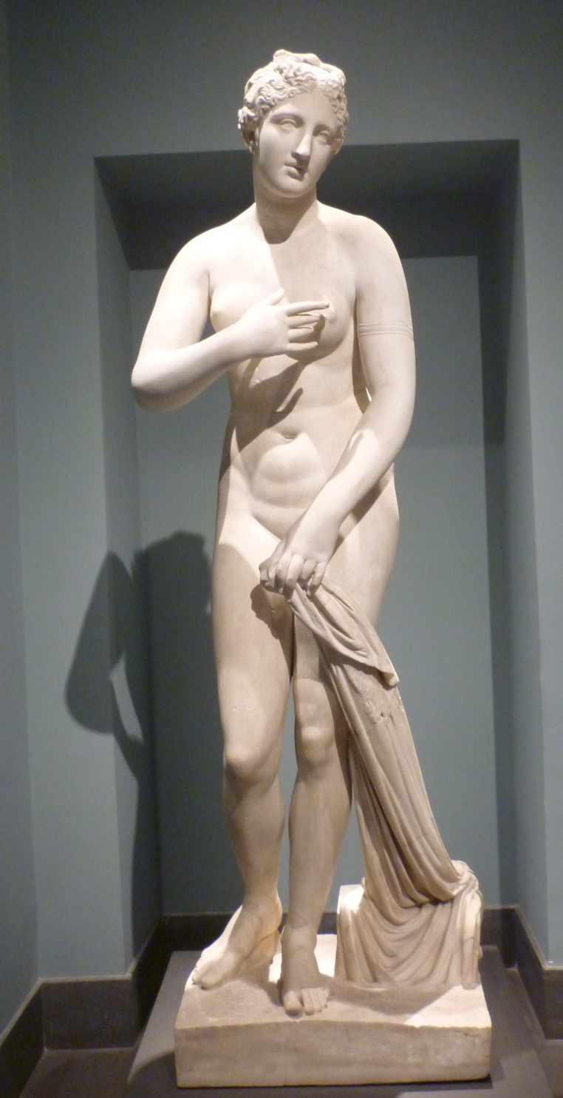
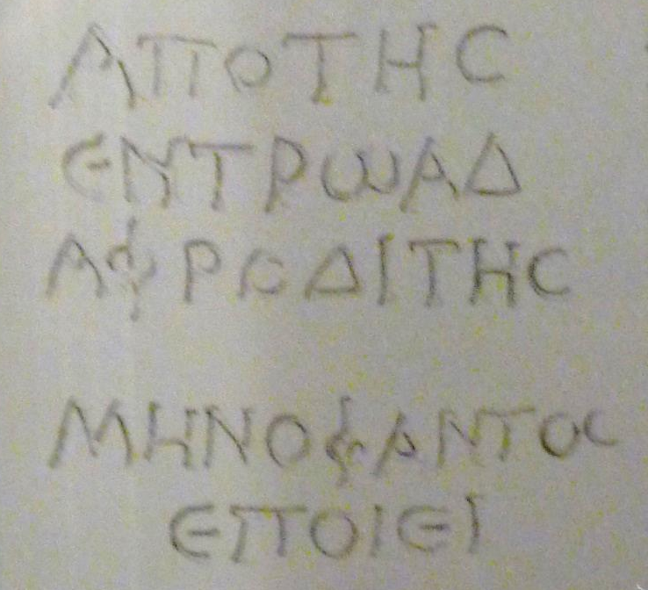
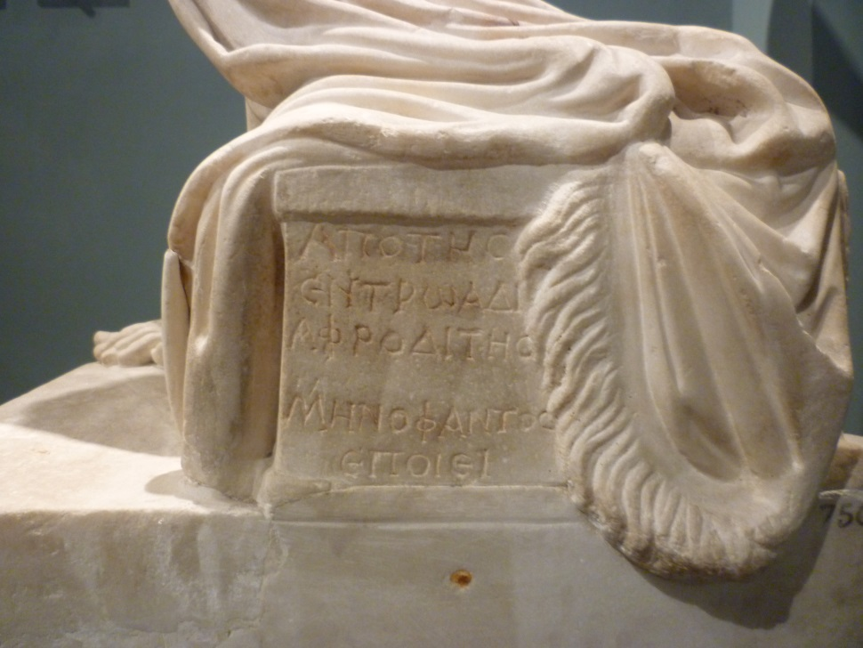
P-MASSIMO

Slide 14
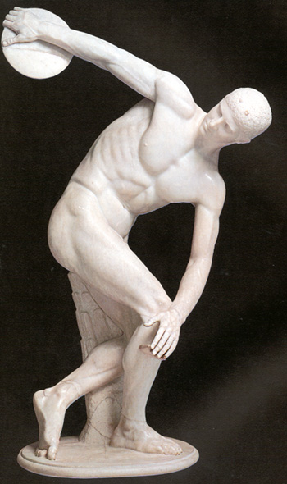
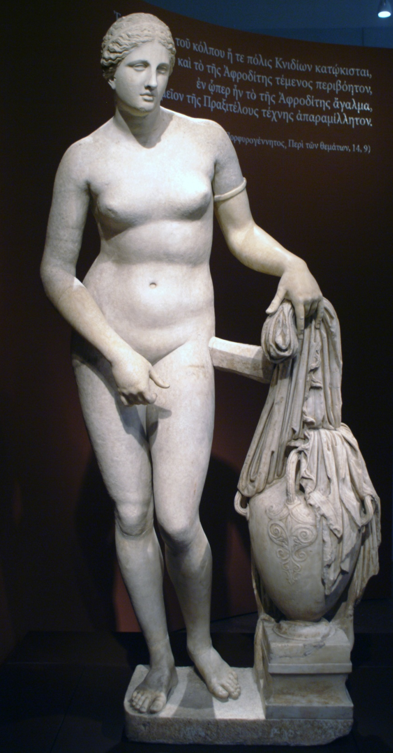
P-MASSIMO
VATICAN

Slide 15
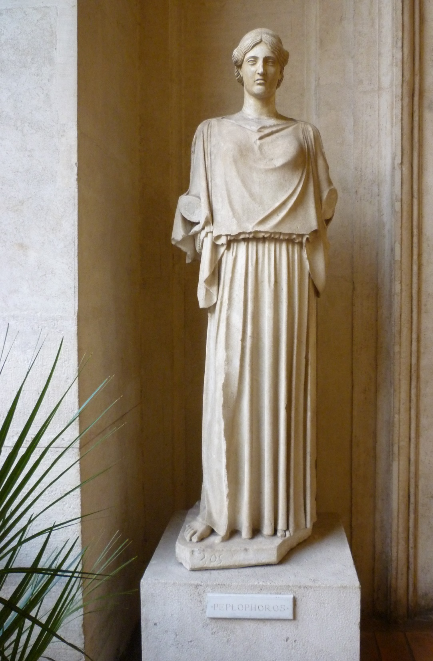
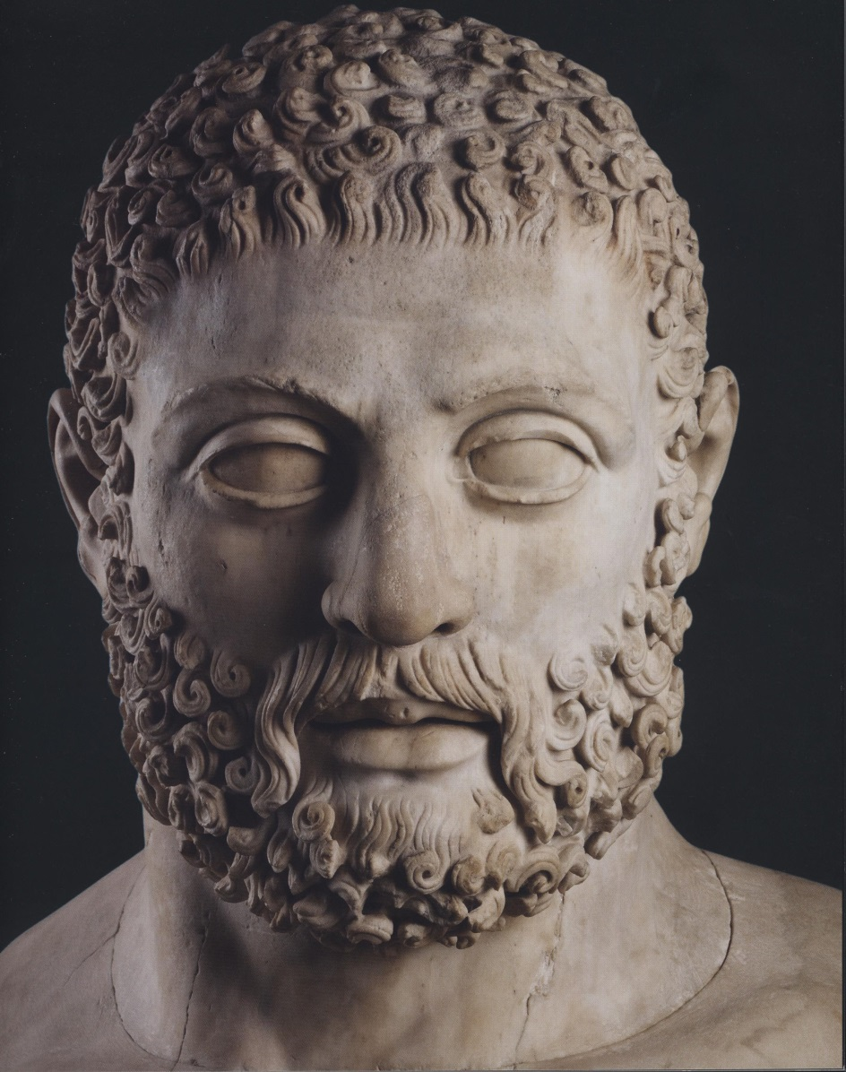
B M
P-ALTEMPS

Slide 16
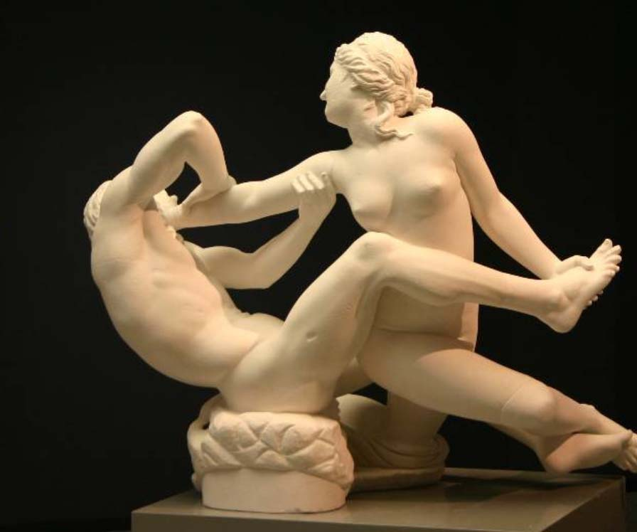
DRESDEN (Cast, Oxford)

Slide 17
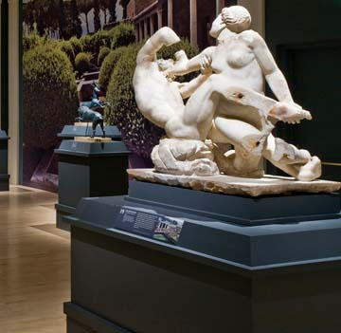
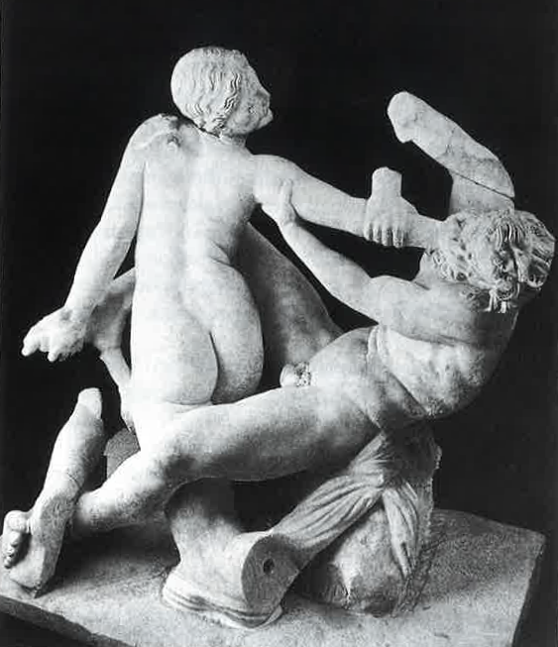
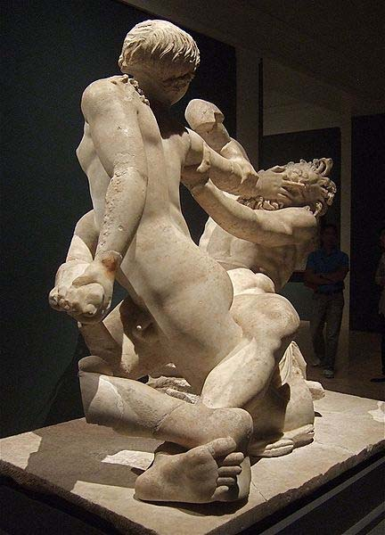
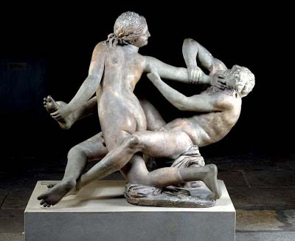
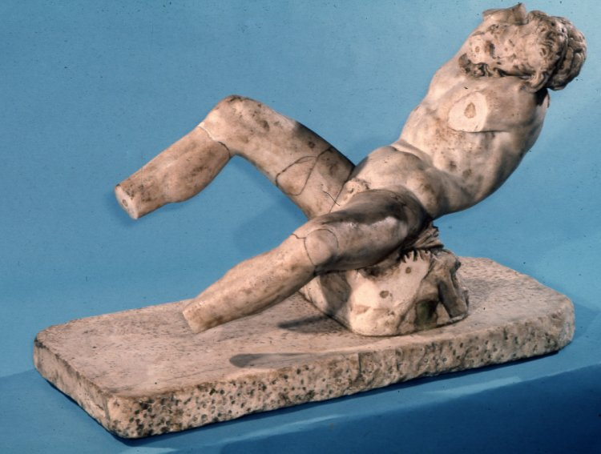
OPLONTIS
OPLONTIS
DRESDEN
B M

Slide 18
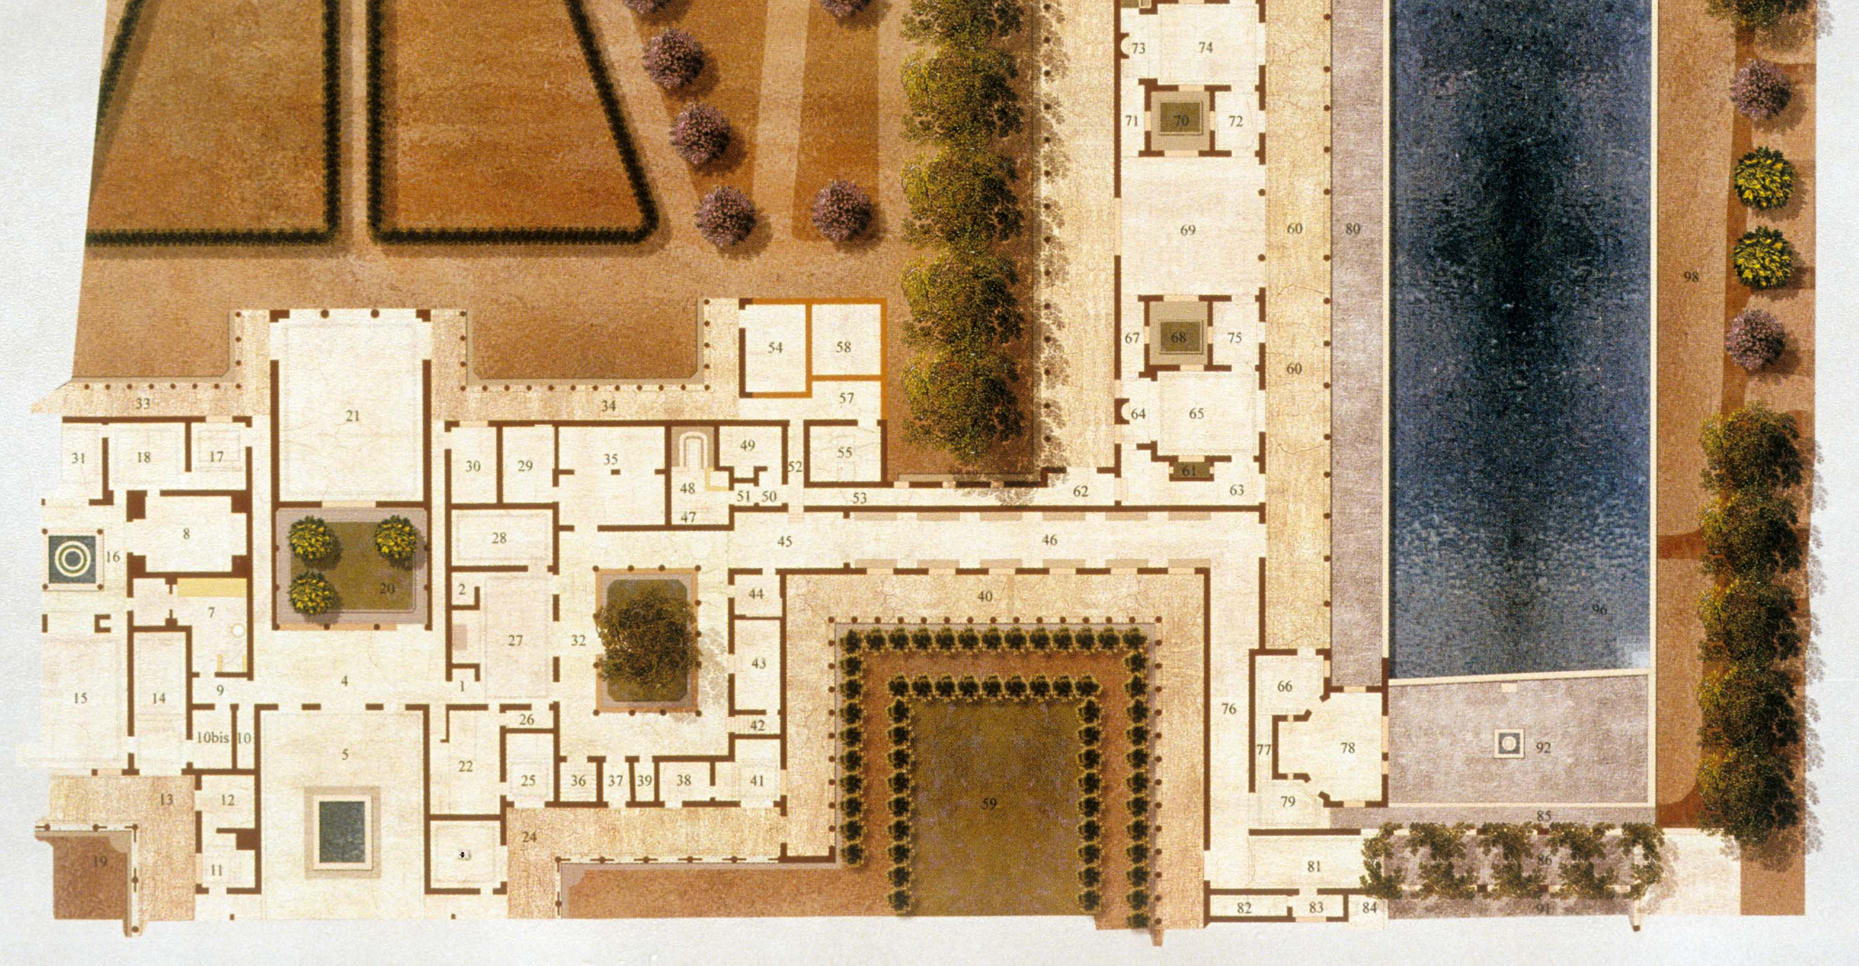
O P L O N T I S

Slide 19
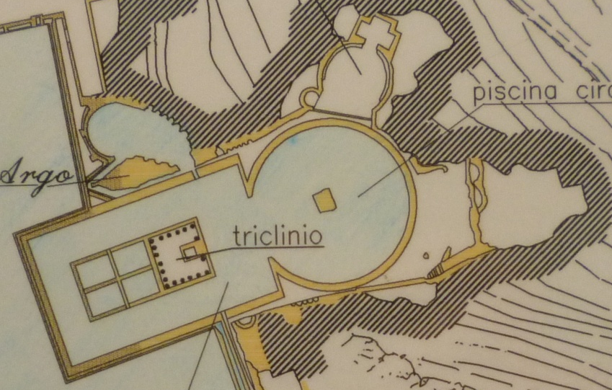
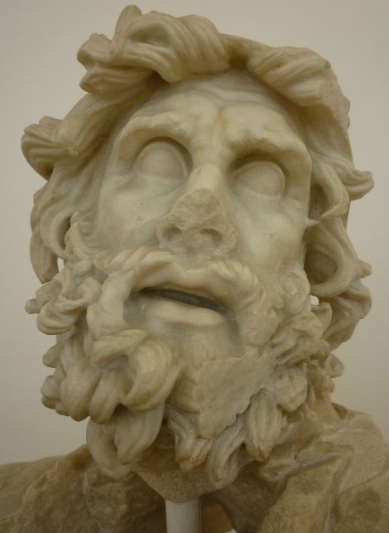
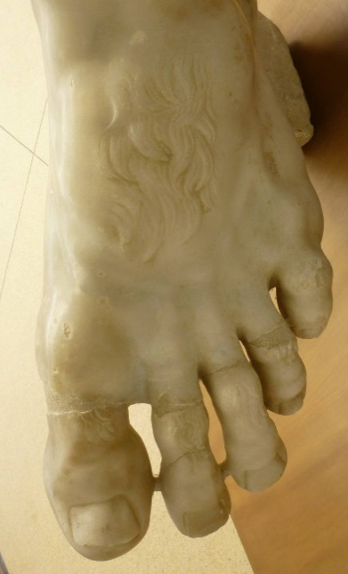
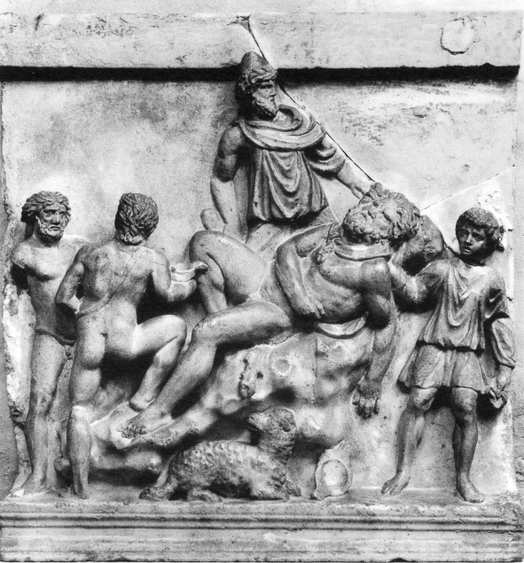
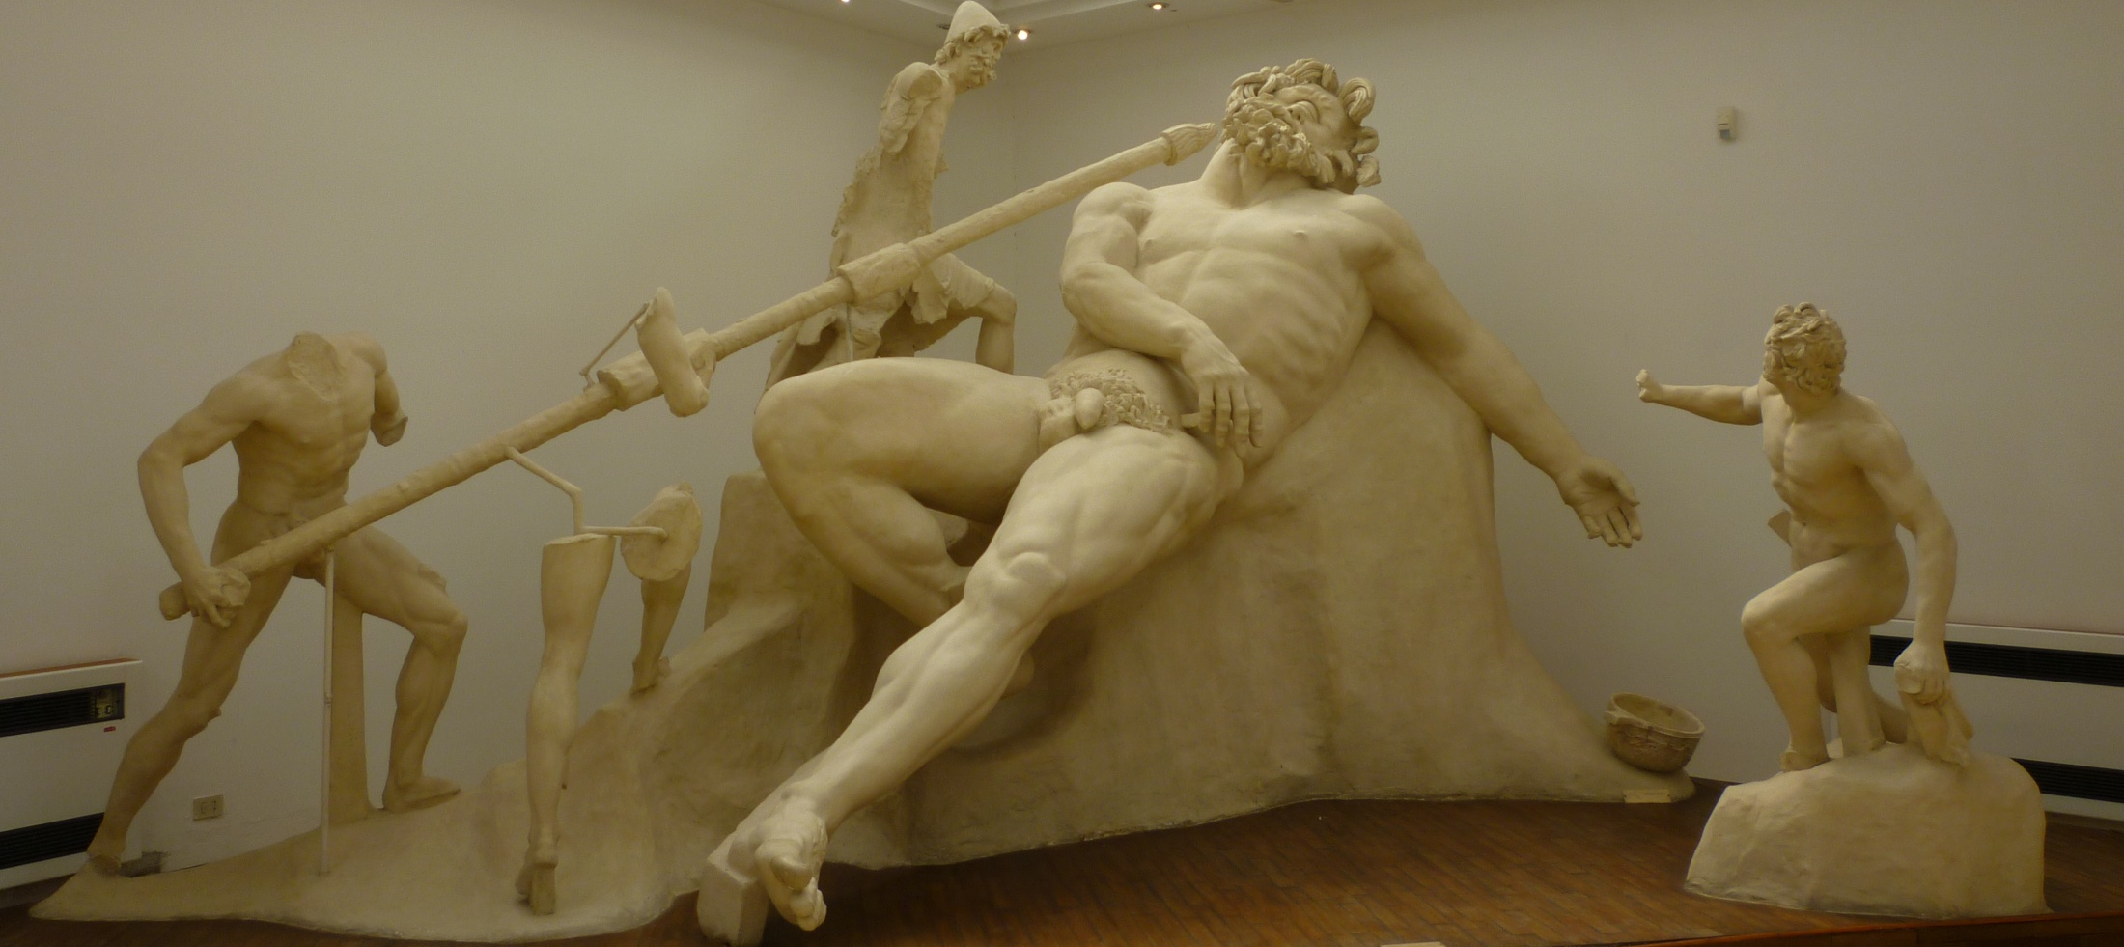
S P E R L O N G A

Slide 20
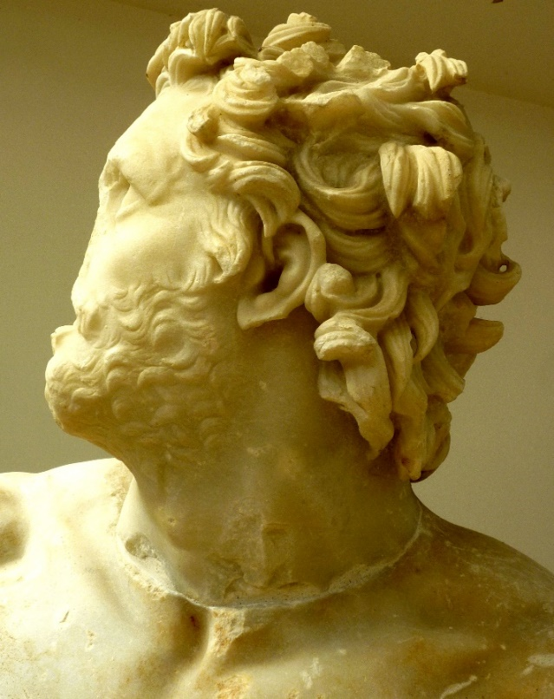
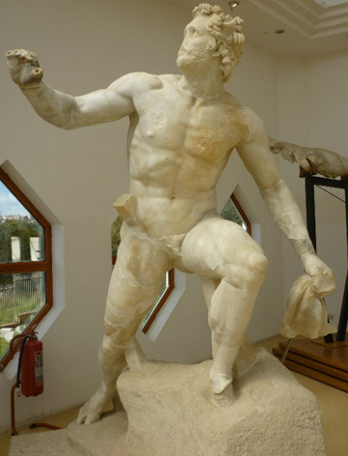


S P E R L O N G A
T I V O L I ( B M )

Slide 21

S P E R L O N G A
T I V O L I ( B M )

Slide 22

S P E R L O N G A
T I V O L I ( B M )

Slide 23


Slide 24



FLORENCE
VATICAN
FLORENCE

Slide 25










Slide 26


SCHL-ERBACH
EPHESOS

Slide 27



JERUSALEM
AVENCHES

Slide 28


EPHESOS

Slide 29


PALATINE
SUFFOLK (B M)

Slide 30



SCHL-ERBACH
EPHESOS

Slide 31


POMPEII
H-FAUN

Slide 32


THMUIS
POMPEII

Slide 33


POMPEII
STABIAE

Slide 34


Not copies: Repeated figure schemes. Andromeda, not Nikias.
PALESTRA, HERCULANEUM
H-DIOSCURI, POMPEII
Pliny, NH 35.135: Nikias of Athens…also painted a Calypso, an Io, and an Andromeda.

Slide 35


H-CITARISTA, POMPEII
H-VETTII, POMPEII

Slide 36

H-PRIEST AMANDUS, POMPEII
BOSCOTRECASE

Slide 37

W
E
BOSCOTRECASE

Slide 38


BOSCOTRECASE

Slide 39

APHRODISIAS

Slide 40

APHRODISIAS

Slide 41




Arretine sigillata, Ashmolean
Black-glaze guttus
Amsterdam
Lamp: LIMC Penthesilea 53g
APHRODISIAS

Slide 42


VATICAN
APHRODISIAS
Roman sarcophagus, c. AD 140 (Vatican)

Slide 43

VATICAN

Slide 44


P-MASSIMO
BERLIN

Slide 45



Jason , Creusa, Medea’s children w gifts.
Silver cup (Bonn).
BONN
BERLIN
BONN

Slide 46

BASEL

Slide 47

BASEL

Slide 48


BERLIN
MINNEAPOLIS

Slide 49

BOULEUTERION, APHRODISIAS

Slide 50


A P H R O D I S I A S
C H L A M Y S & T O G A
HADRIANIC BATHS
BOULEUTERION

Slide 51


BEGRAM
APHRODISIAS

Slide 53





POMPEII
VELLEIA

Slide 54

RHAMNOUS (Athens, NAM)
DELOS (Athens, NAM)

Slide 55


