Slide 1
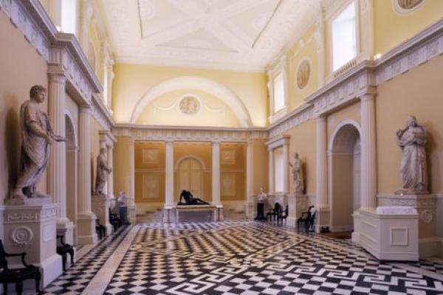
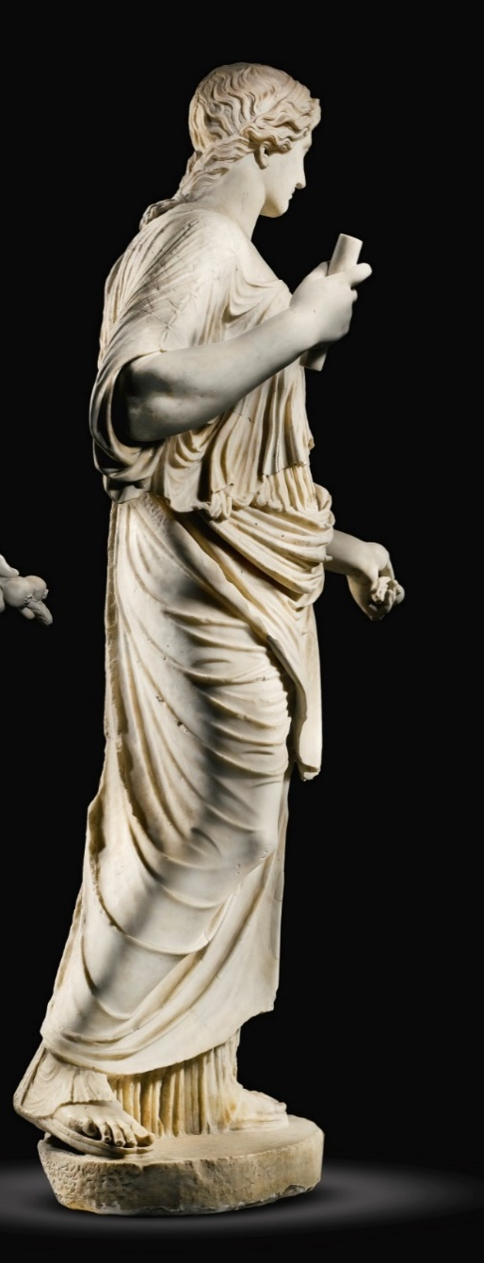
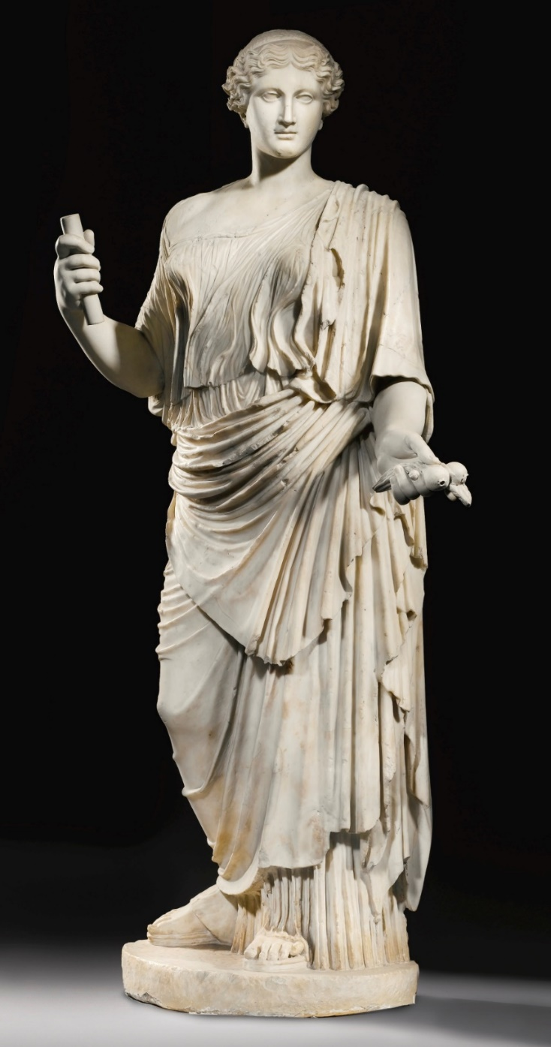
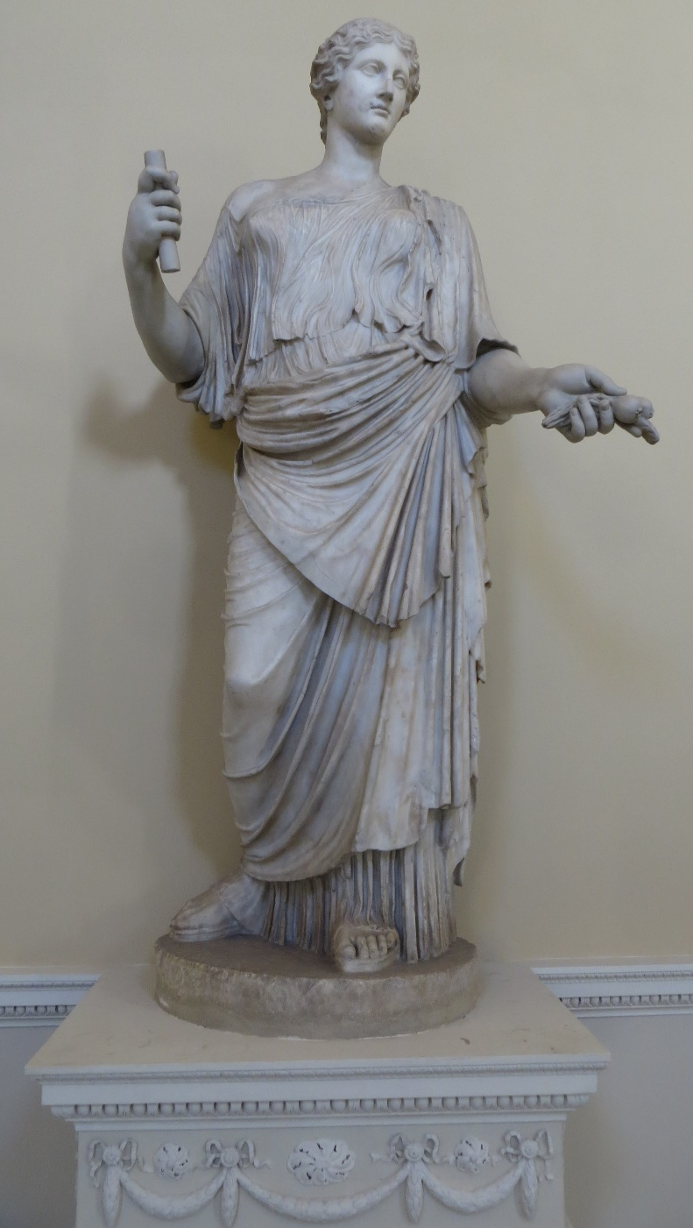
Copy redeeMEd: the case of the Syon Aphrodite
“copy” more important than an “original”: the case of the Syon Aphrodite
The fluctuating value of the Roman marble copy: the case of the Syon Aphrodite
“bellissima statua, ma non ha braccia. Fu questa Agrippina figliuola di M. Agrippa, e di Iulia figlia d’Augusto“ Ulisse Aldroandi 1562
“The Empress Livia, in the character of a Juno in flowing robes, of Grecian workmanship remarkably fine, from the Pope's collection in the Vatican” Christie’s 1 March 1773
“typical … of over-life size Roman marble female draped statues…of inferior quality”
Christie’s, 2014
Notes:
Perfect case study. It embodies much of discussusion—from evaluation of a statue without context, technicalities of copying, to buyer’s desires. The statue went on sale at Christies in June of 2014 at which point cultural institues from museums to the government to the auction house wanted to know what really was its value and how do we quantify it. This paper represents my experience with this question. As a taster of its different values, the three quotations

Slide 2
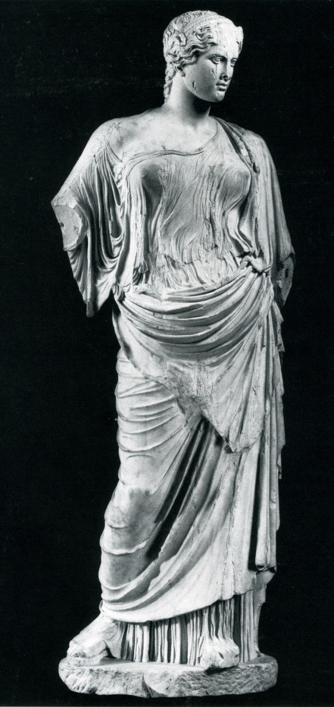
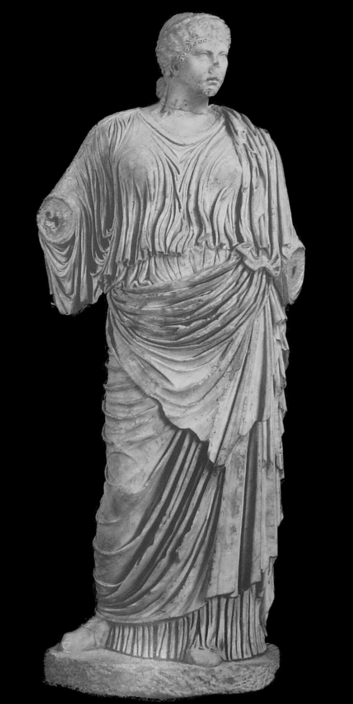
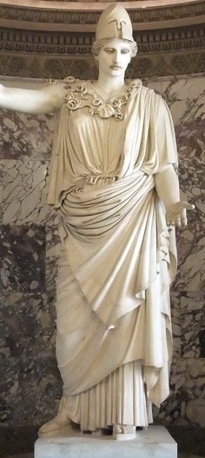
I. History of Syon statue
II. Typology and Manufacture
III. Roman Use
IV. The Greek “Original”
Notes:
Four parts. 1-2 overlap. 4. to memory of E. Harrison who taught me to look.

Slide 3
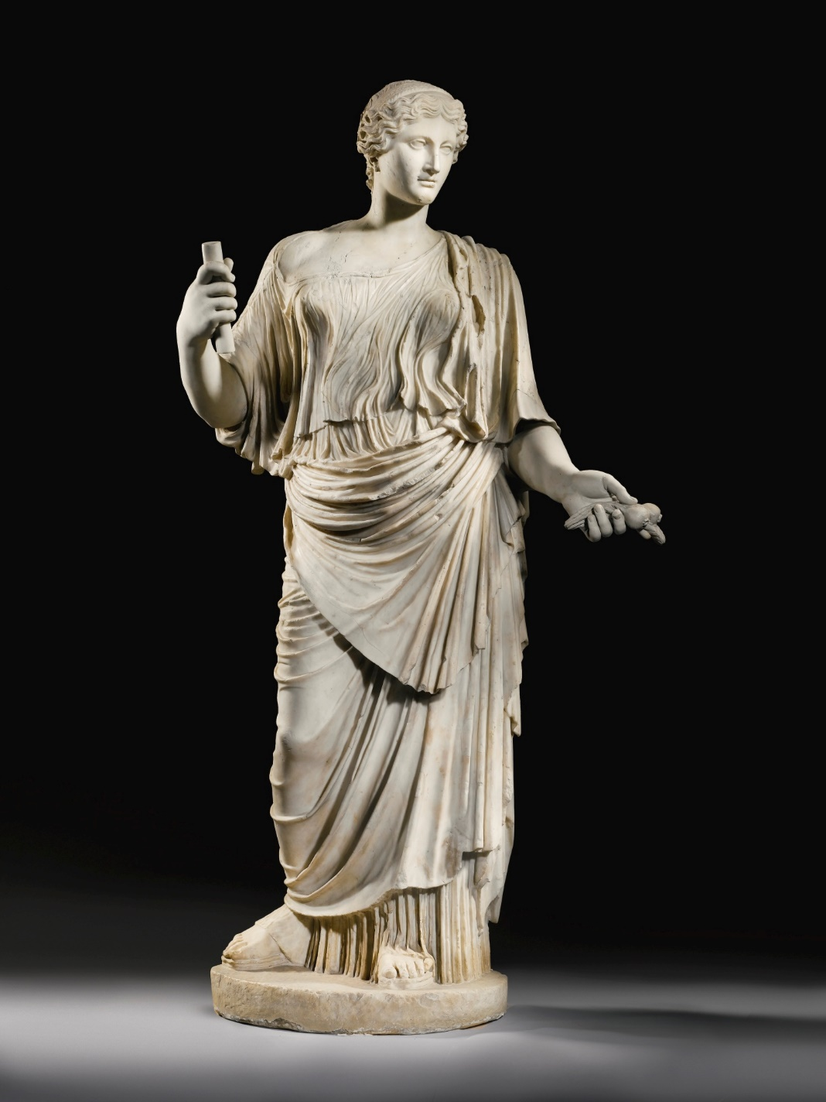
Entrando in questo giardino [of the Cesi] si trova à man dritta presso al muro una Agrippina intiera in piè vestita à l’antica e posta sopra una antica base. E bellissima statua, ma non ha braccia. Fu questa Agrippina figliuola di M. Agrippa, e di Iulia figlia d’Augusto perche furono molte Agrippine
Ulisse Aldroandi, 1562
Agrippina Marci Agrippae filiae ibidem [=in the same place as the previous illustrations which are in the Cesi collection].
1585 engraving by Cavalleriis
I. History of Syon statue

Slide 4
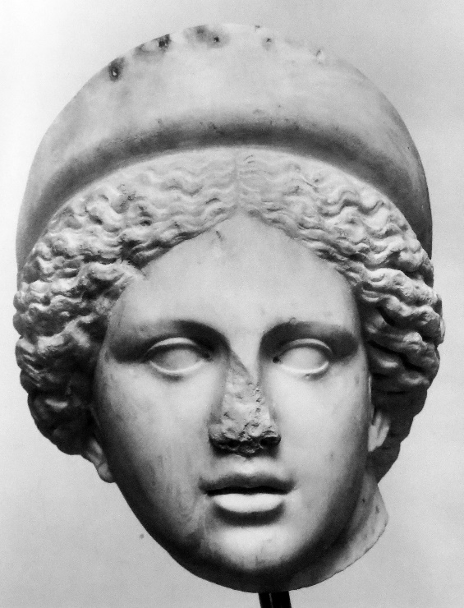
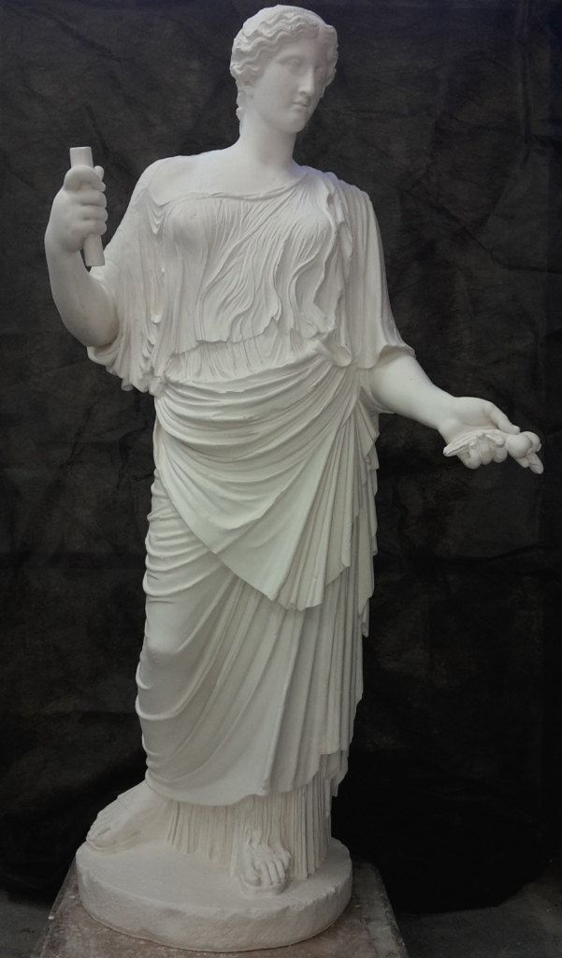
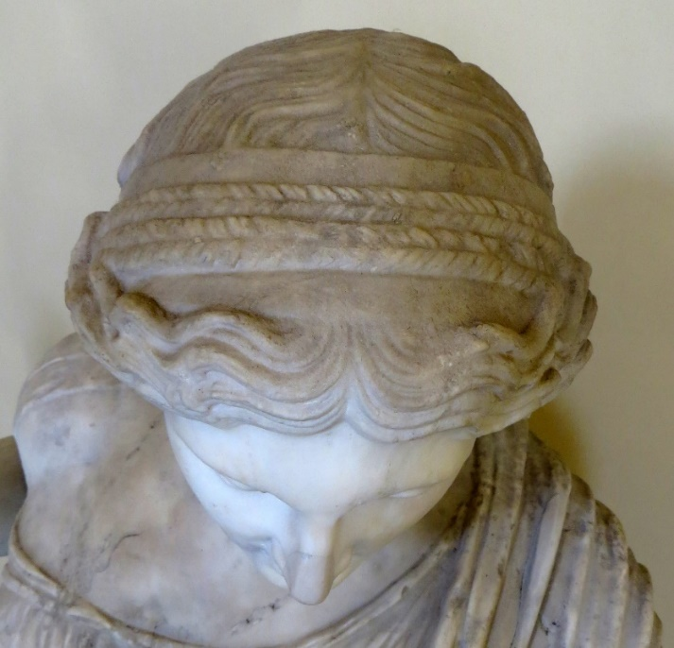

Slide 5
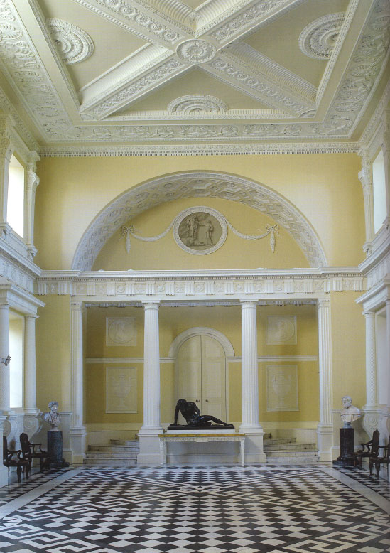
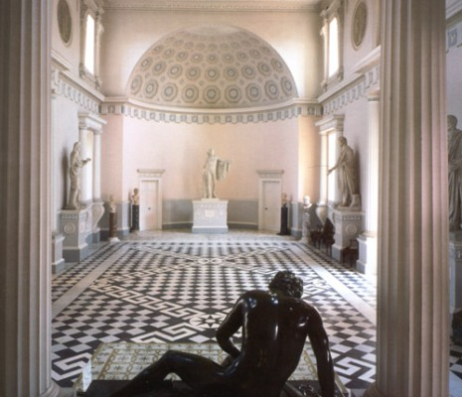
1 March 1773 sale, Superb Antiquities were purchased by the Mess. Adam, during their stay in Italy, from the most celebrated collections of that Country; namely, that of the Vatican, Barbarini, Matei, Furietti, Massimi etc.:
The Empress Livia, in the character of a Juno in flowing robes, of Grecian workmanship remarkably fine, from the Pope's collection in the Vatican, Ft 6 In 8.5 [204.47 cm]

Slide 6

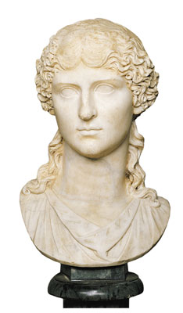
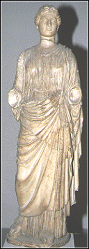
“The so-called Livia has a modern head, copied from that of the Agrippina the Elder in the Capitoline Museum, and placed on an antique statue" F.Poulsen, 1923
“[Poulsen] considered eight ancient portrait statues and busts, and mentioned that the so-called Livia had a modern head set on a body, the inflated drapery of which indicated a copy of the period of Claudius and from “a well known statuesque type.” This torso is in fact the body type of the “Kora” Grimani in the museo Archeologico, Venice." Vermeule, AJA 1955

Slide 7
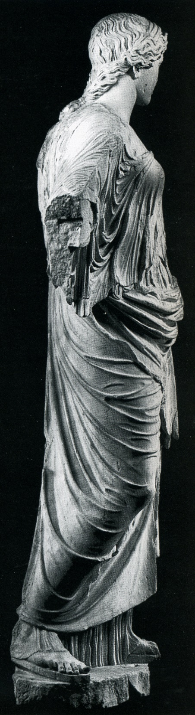
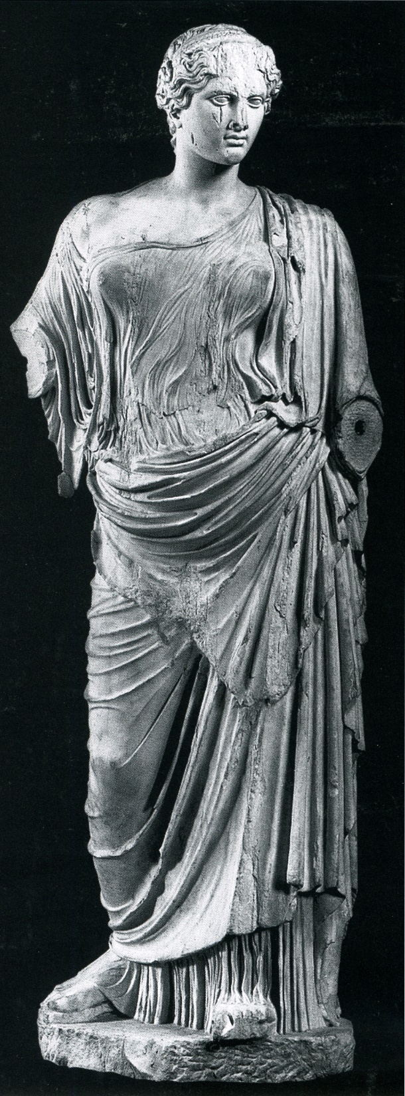
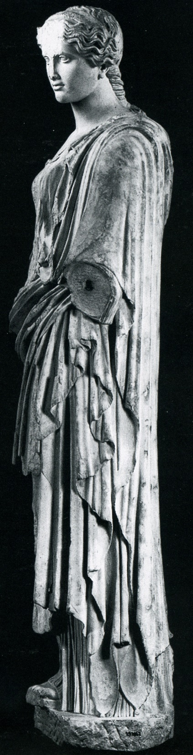
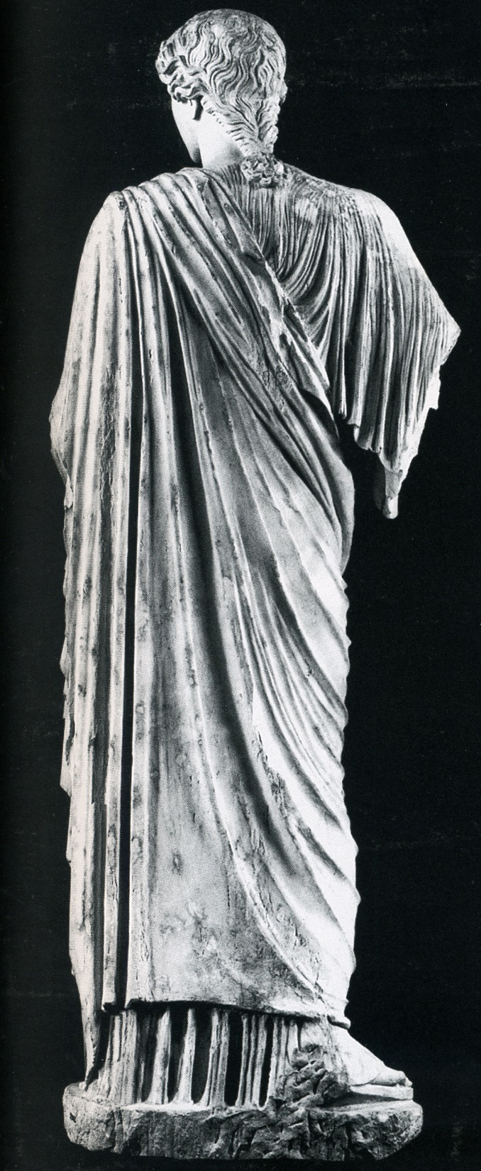
II. Typology and Manufacture

Slide 8
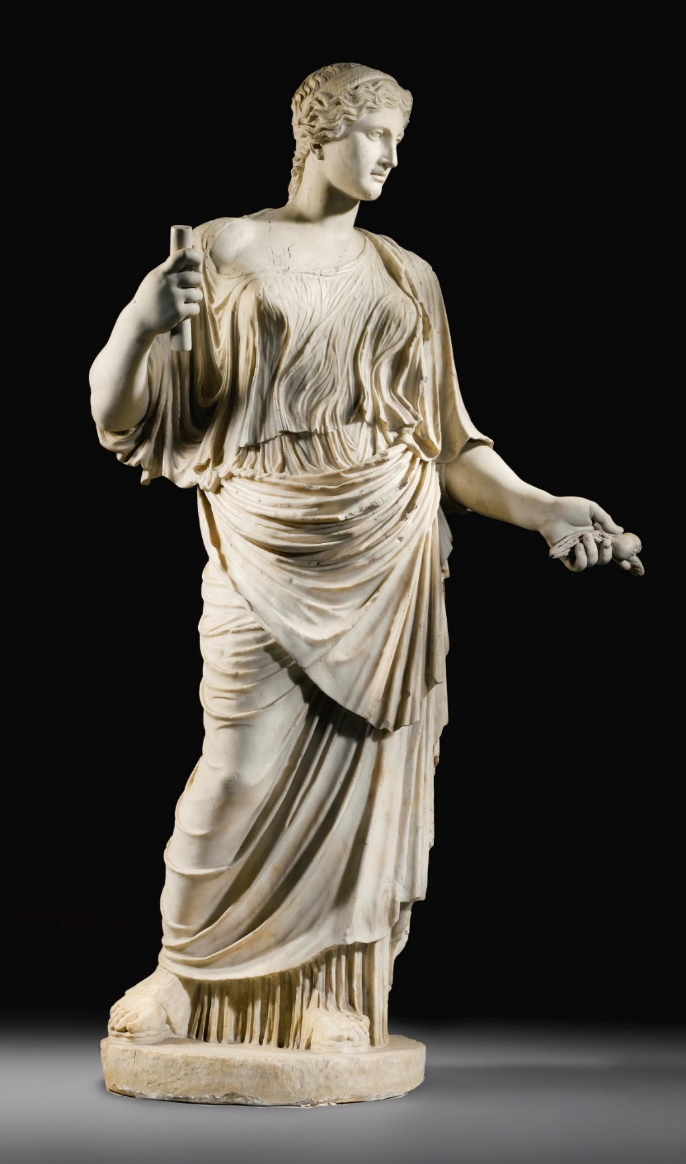
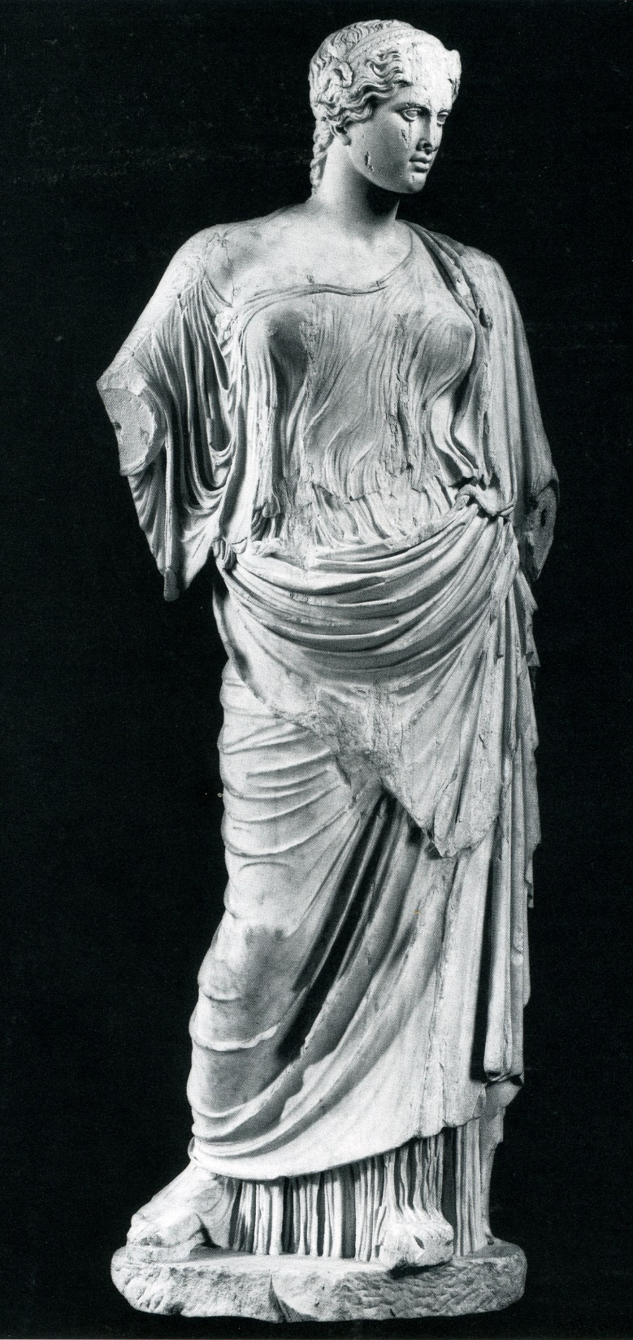
Syon-Munich-Pozzuoli Type

Slide 9
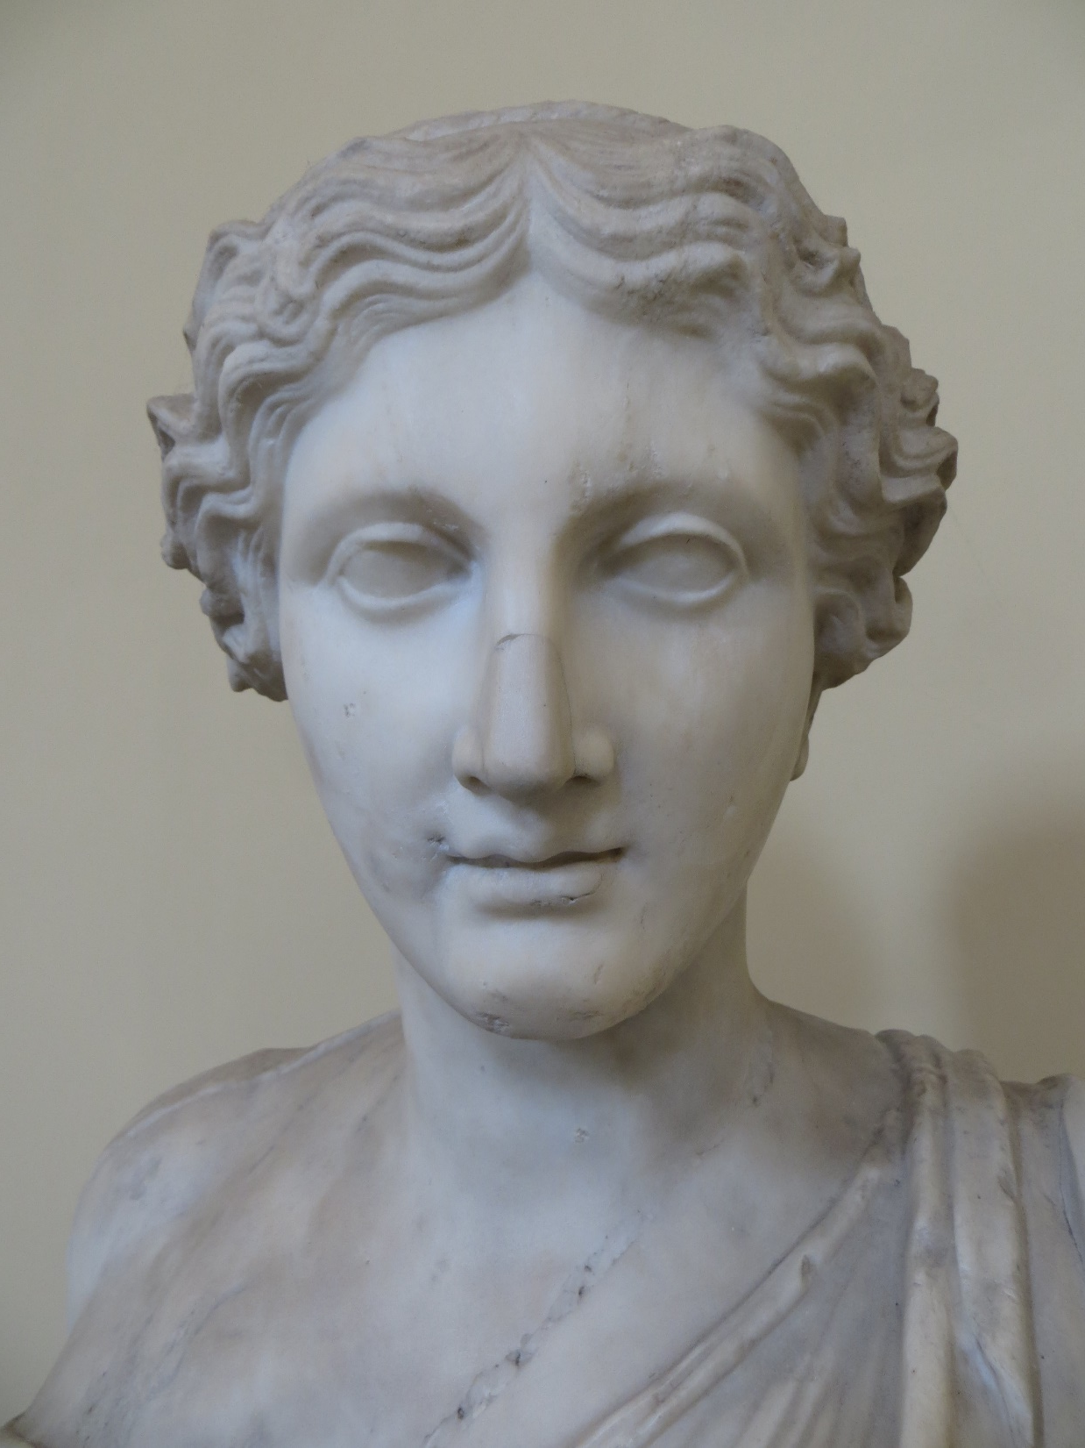
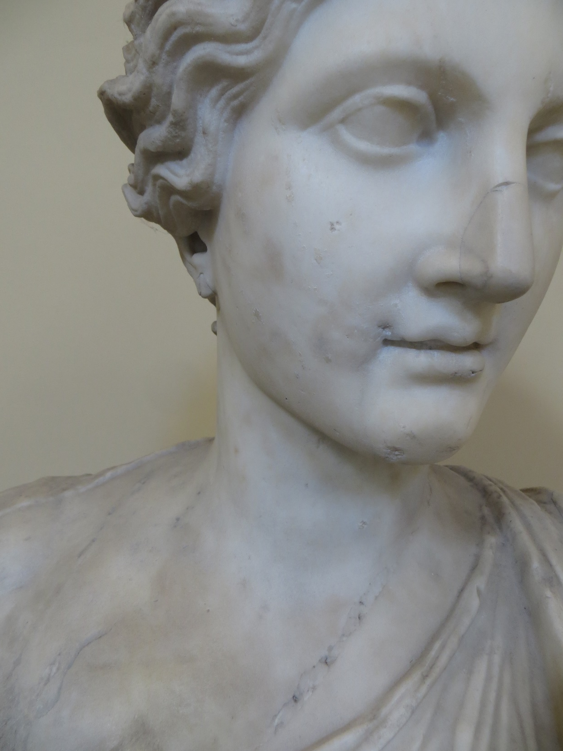

Slide 10
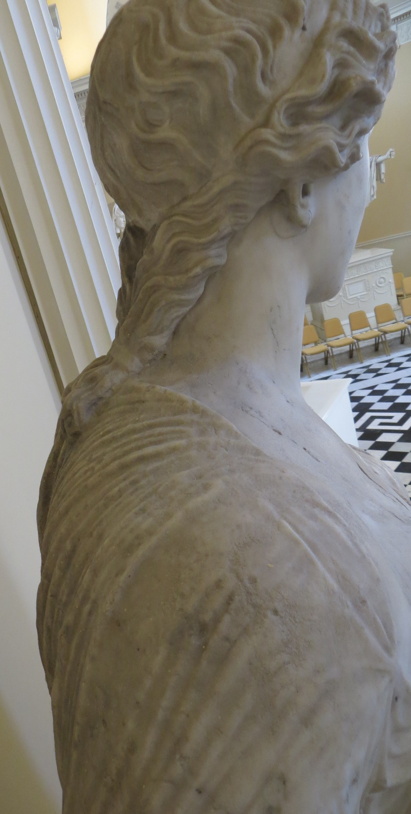
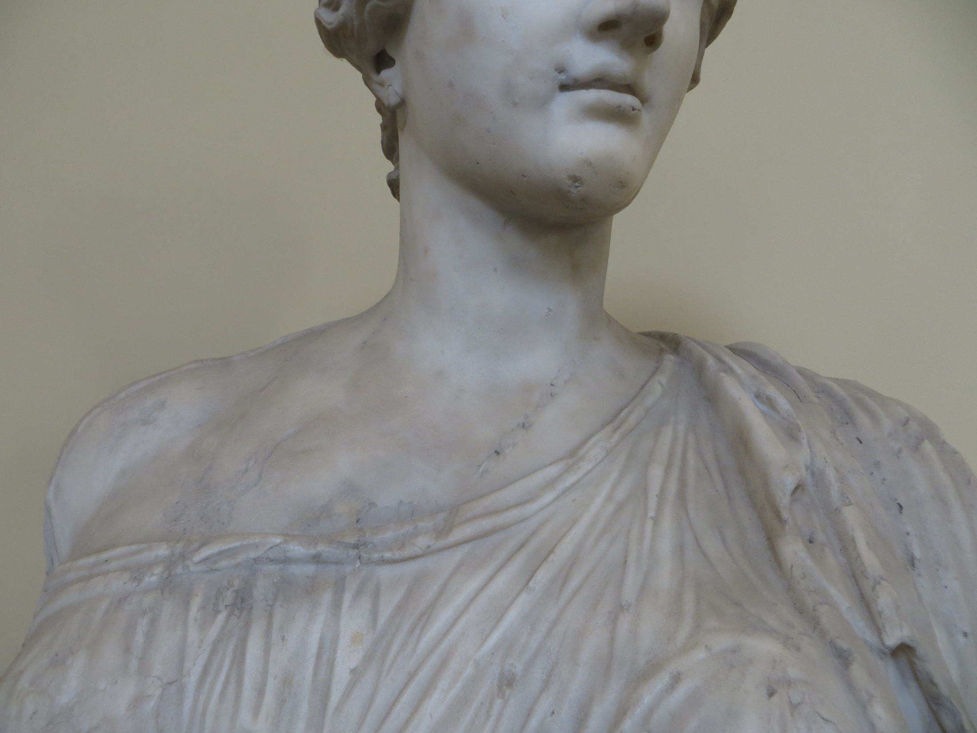

Slide 11
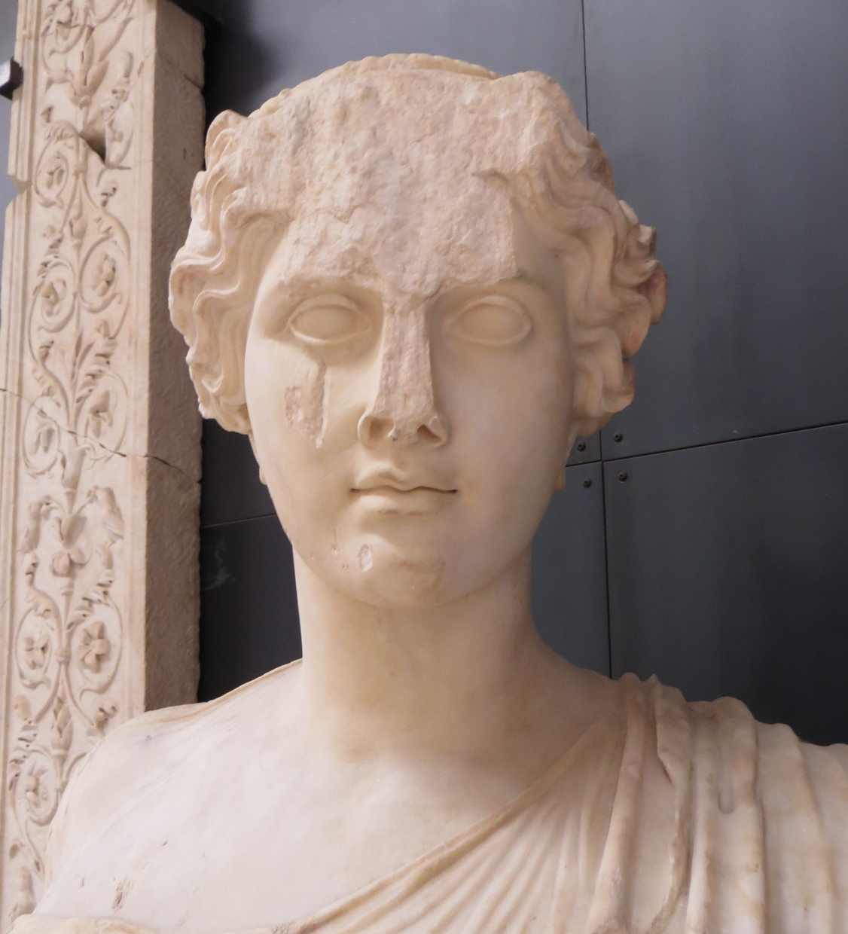

Slide 12
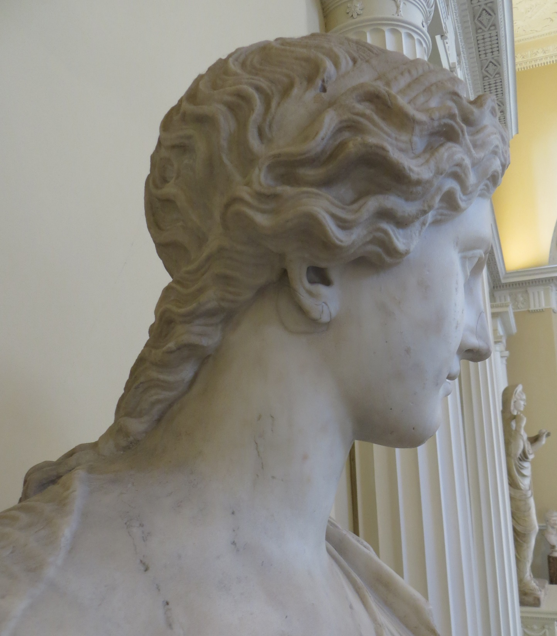
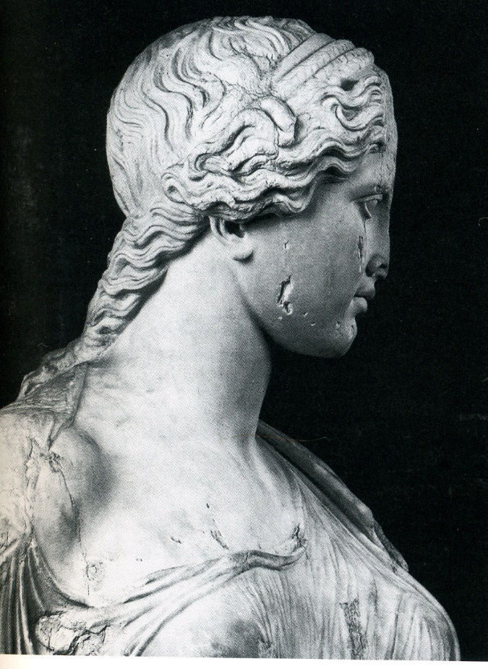

Slide 13
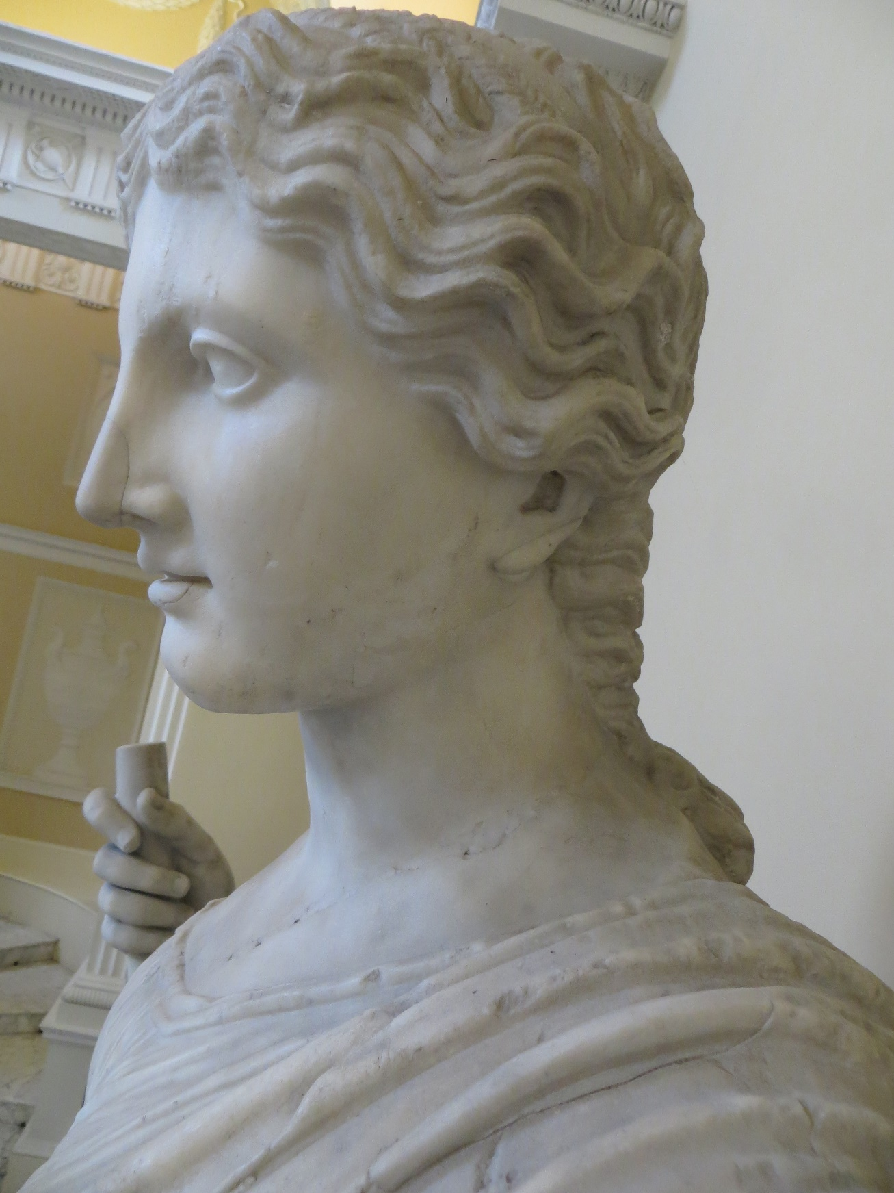
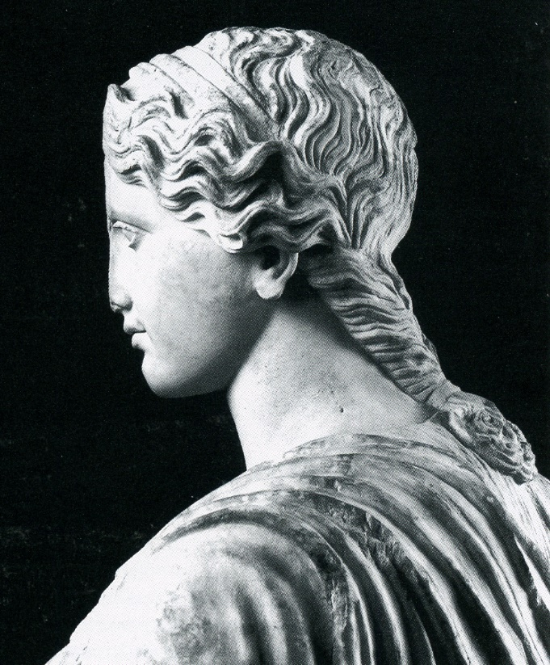

Slide 14

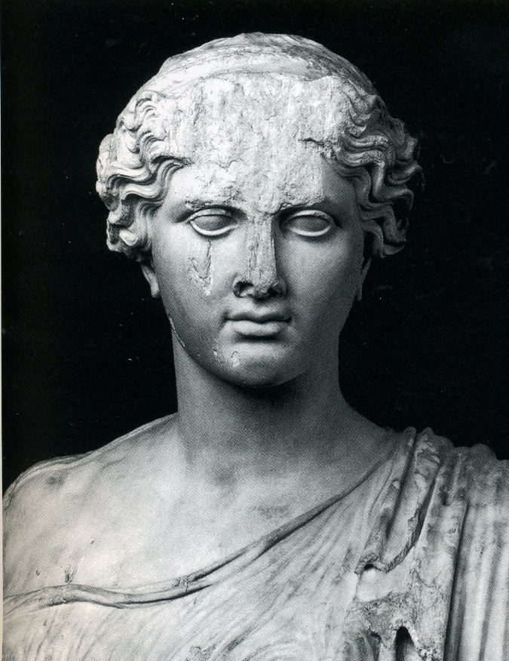

Slide 15
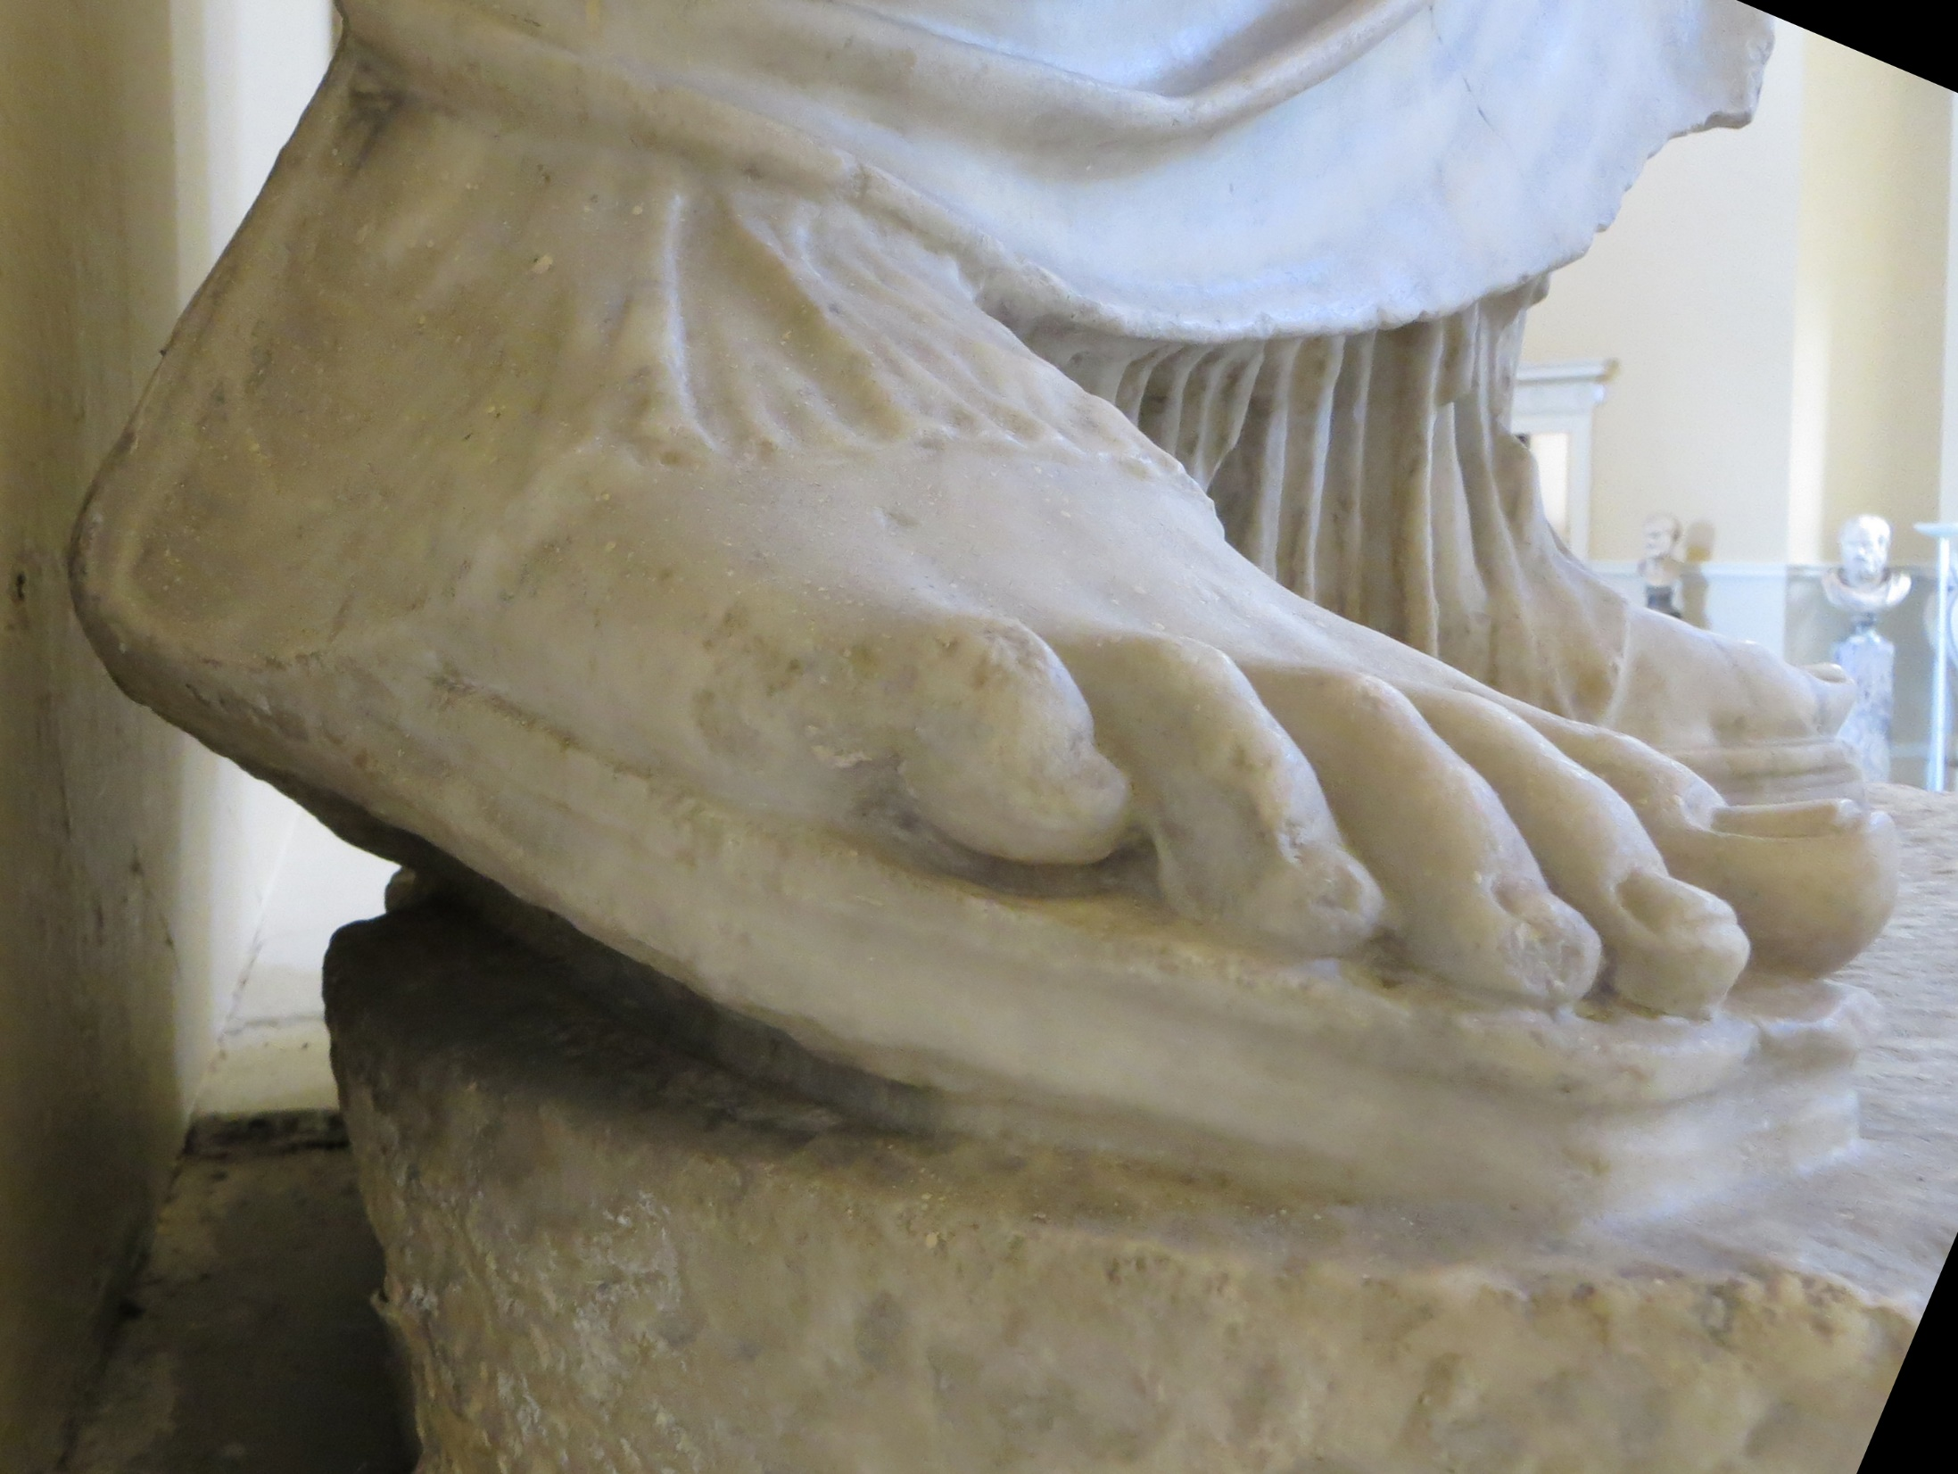

Slide 16
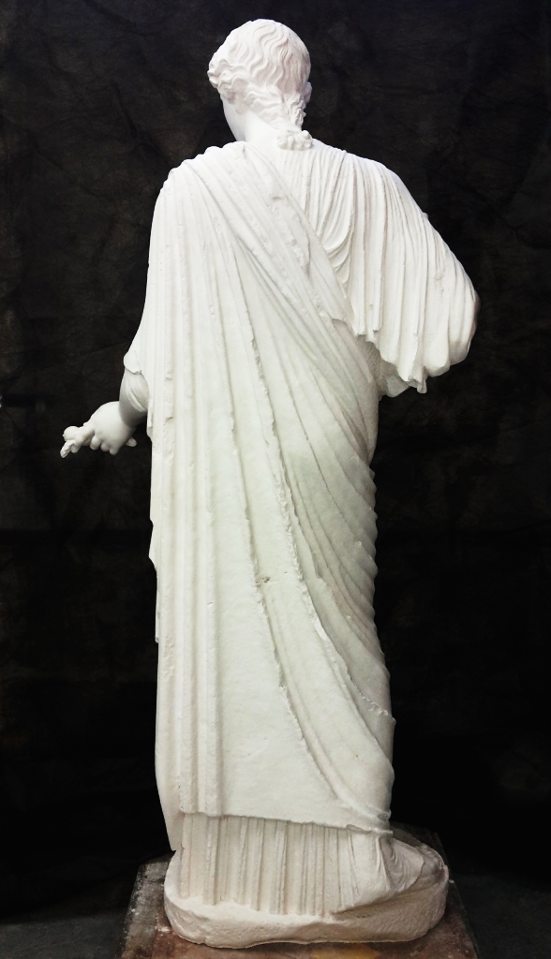

Slide 19
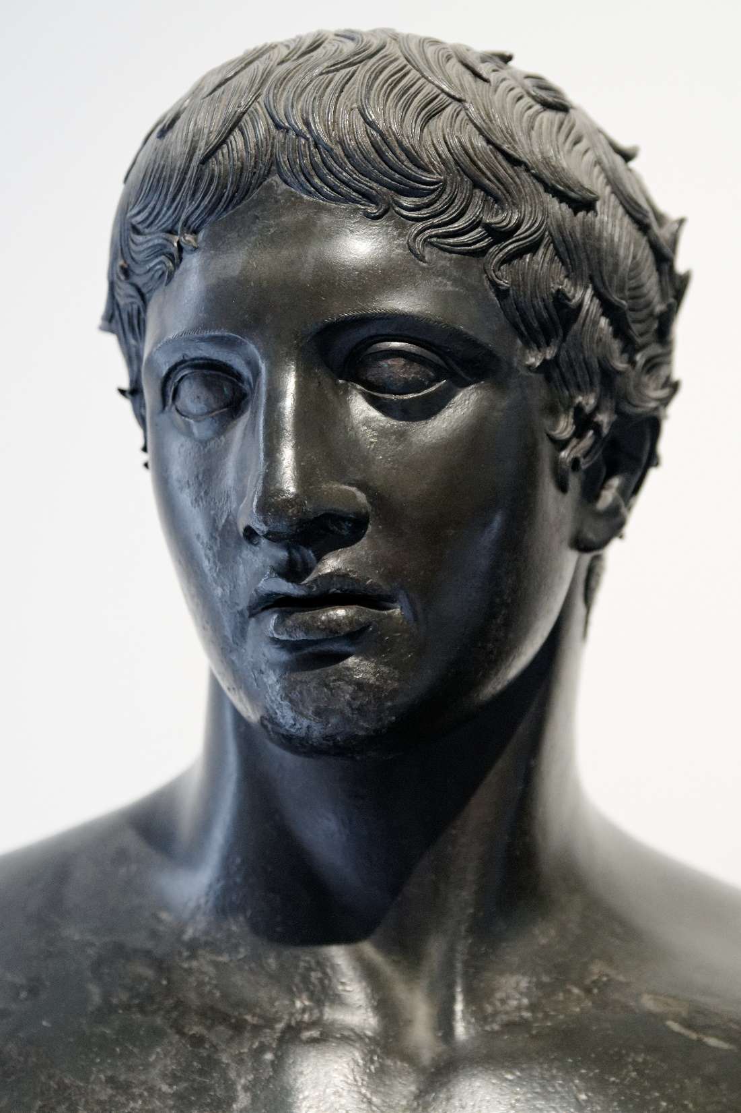
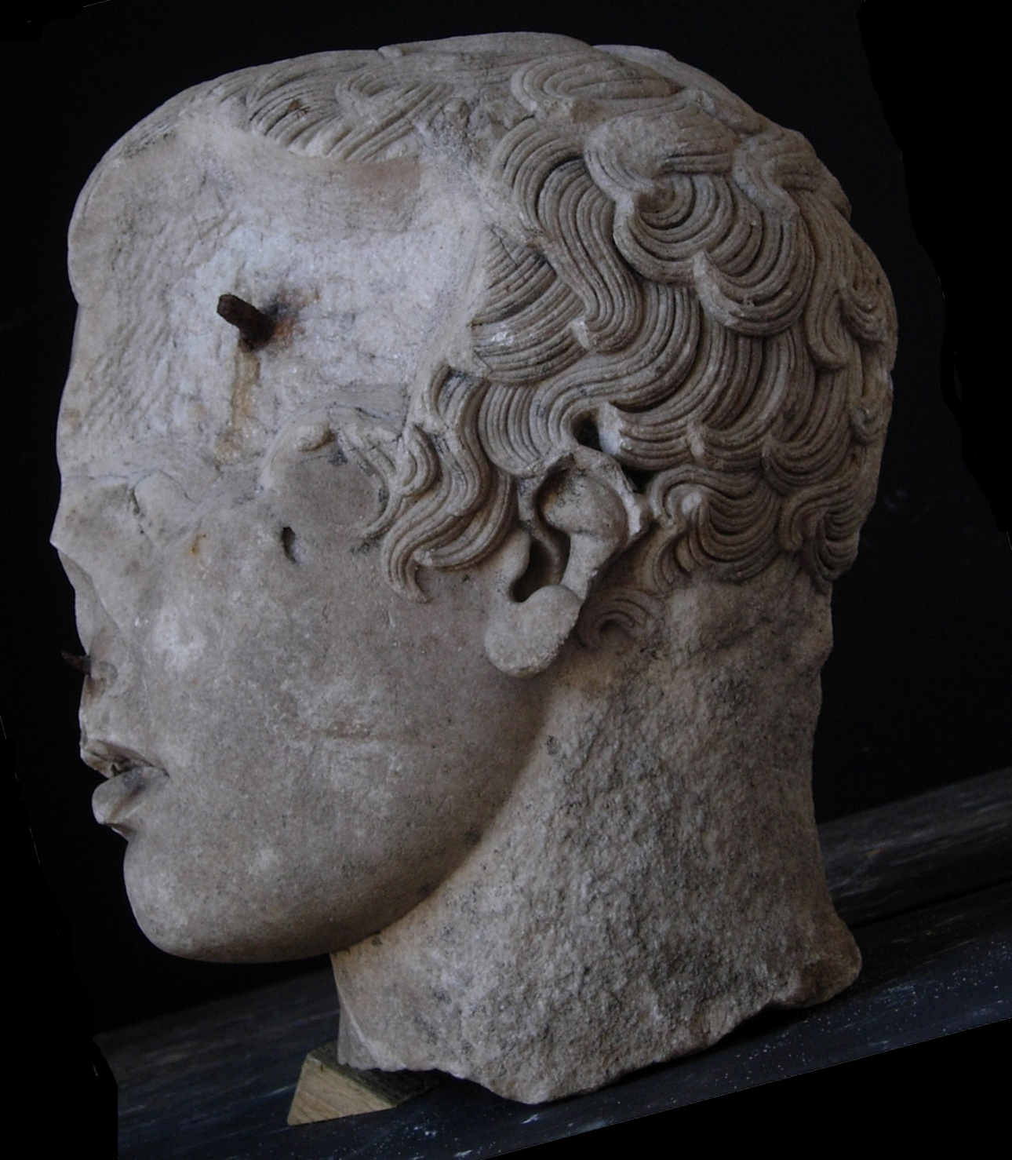

Slide 20
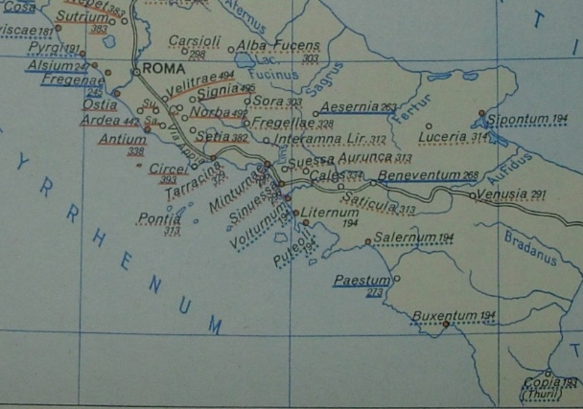
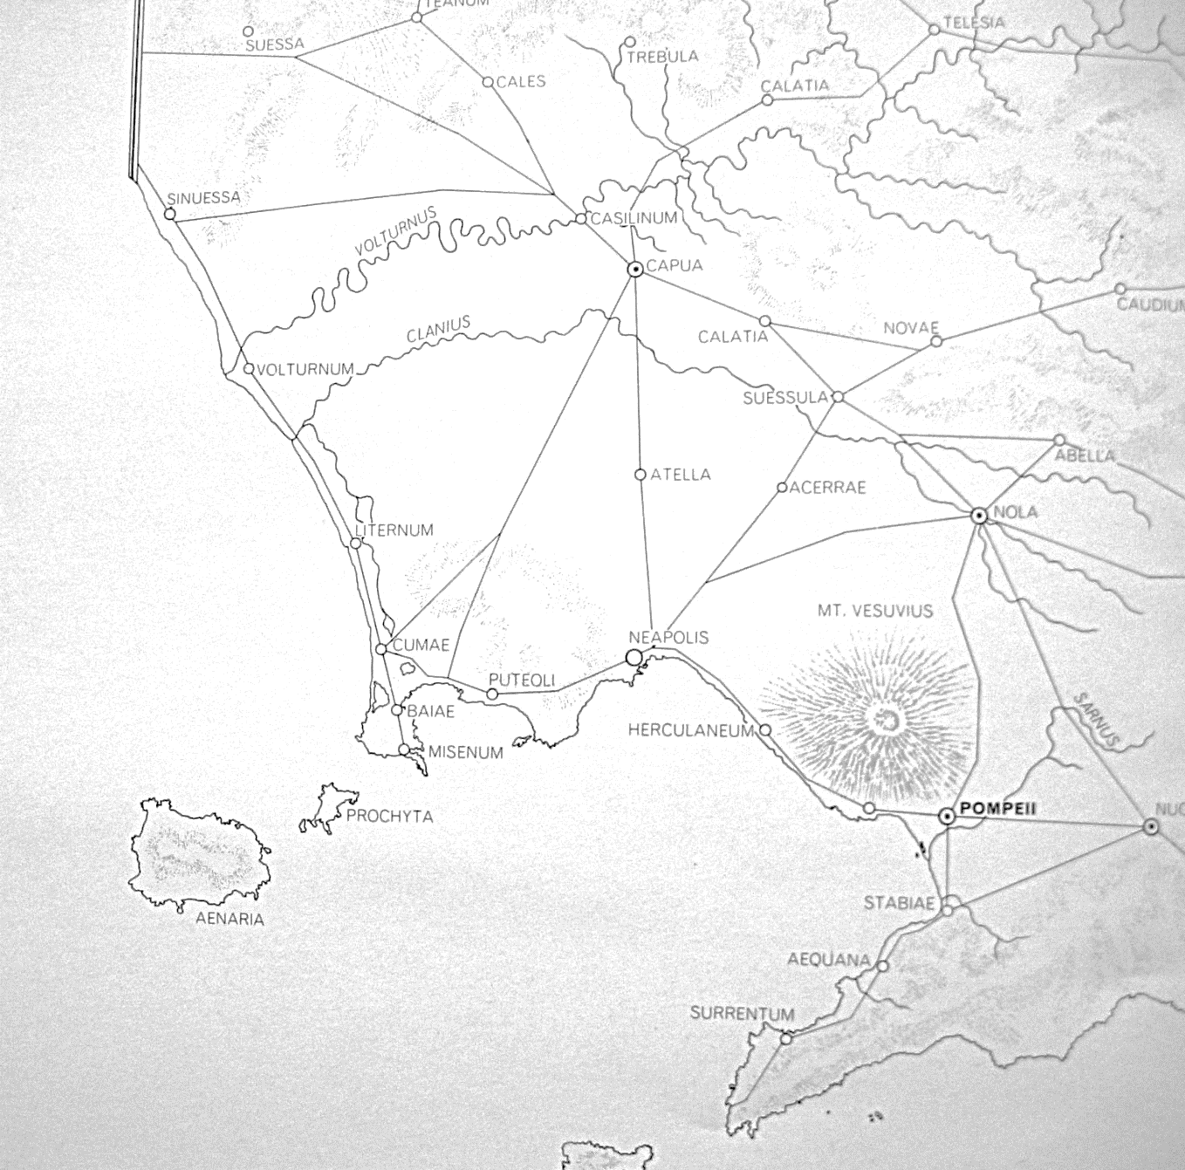
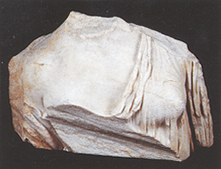
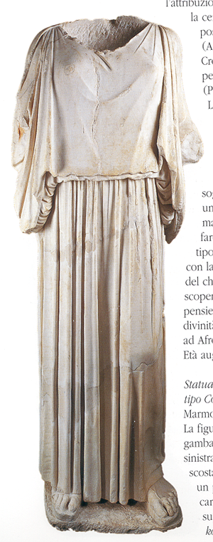
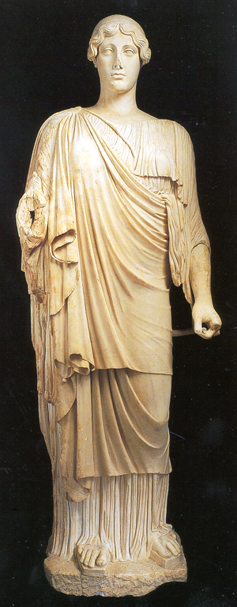
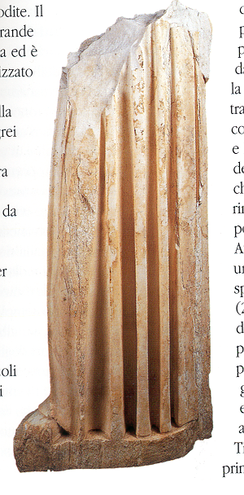
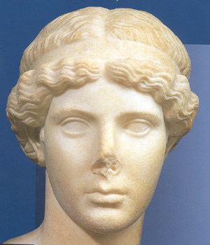
Baiae Casts
Amazons, Aristogetion, Corinth Persephone, Athena Velletri, Hera Borghese, Westmacott Youth
Rione Terra
Syon-Munich-Pozzuoli type, Athena Lemnia, Corinth Persephone, peplophoroi, Hera Borghese,
Notes:
Hera Borghese, Candia Pelophoros, mirror reverse of Candia, Persephone (Barraco-Budapest head and body with copy in Vatican), Lemnia

Slide 21
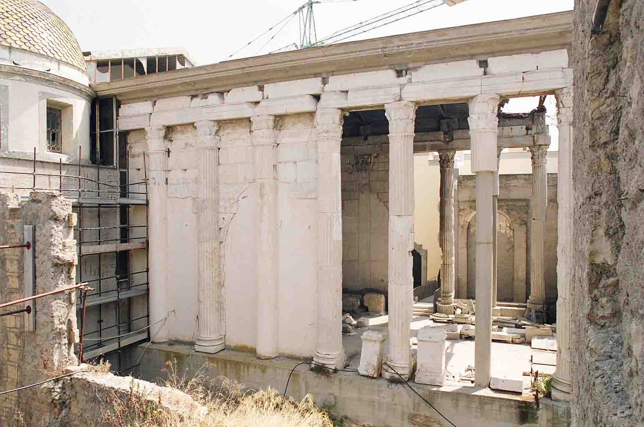
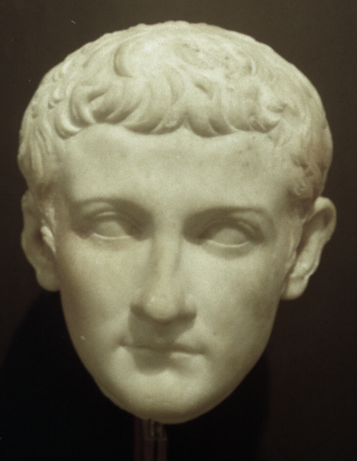
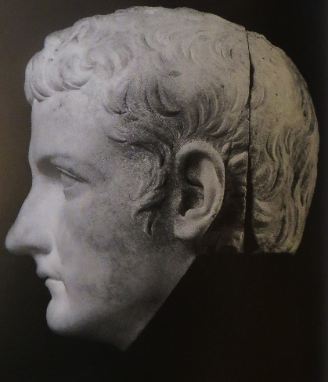
Notes:
First century AD copy in Italy, seemingly by sculptors from Athens.

Slide 22
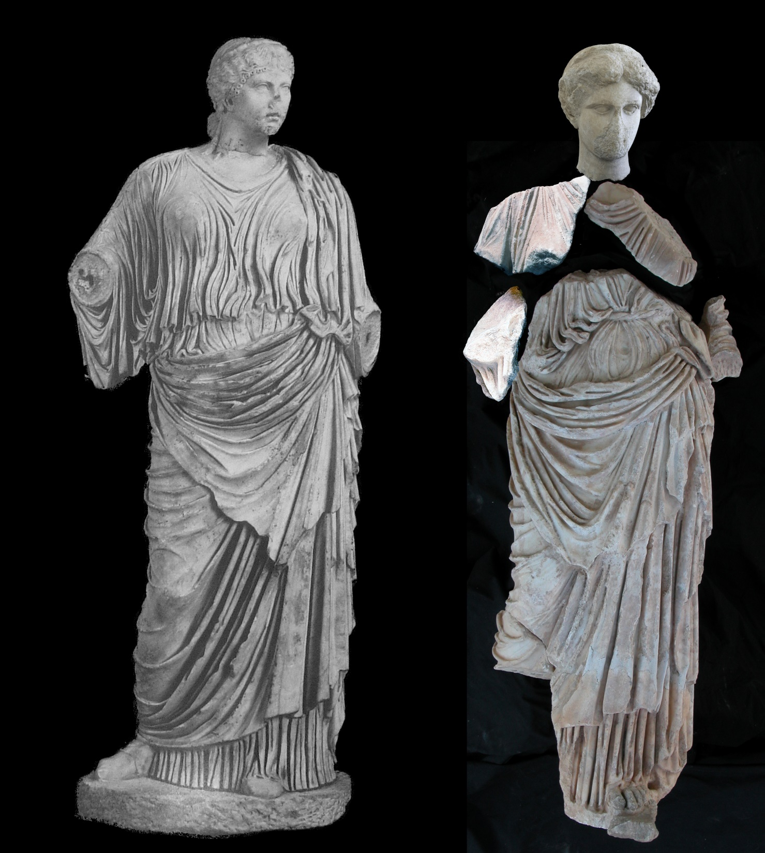
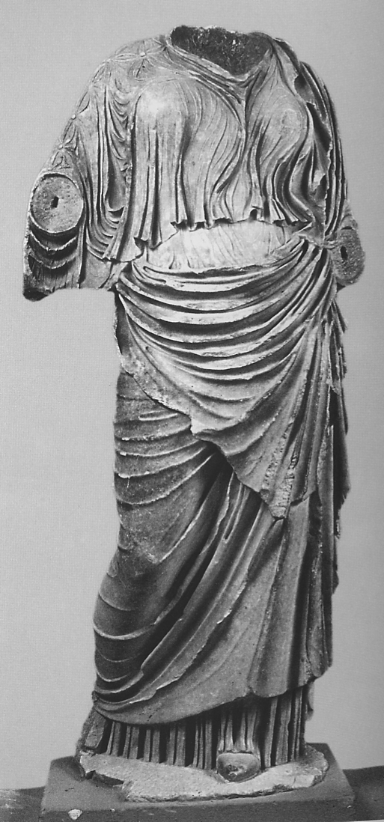
Caere
Epidauros
Formia
III. Roman Use

Slide 23
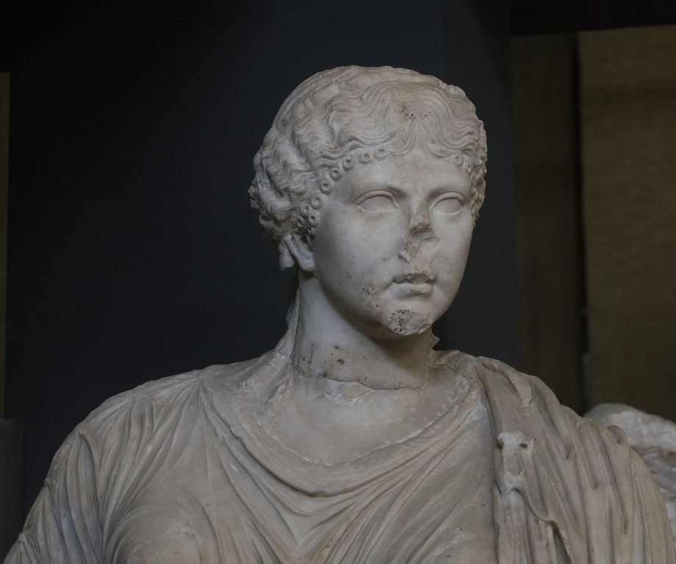
Caere
CIL XI 3598
DIVAE DRUSILLAE SORORI/ [C.Caesaris] AVGVSTI/ GERMANICI

Slide 24
Caere
Epidauros
Formia

Slide 25
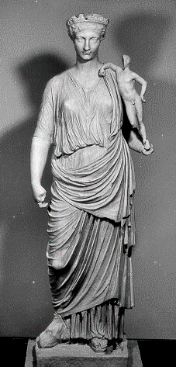
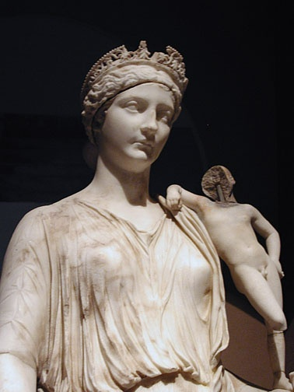
Baiae

Slide 26

Aphrodisias

Slide 27


Slide 28


Notes:
Practical use of kopienkritique from Ephesus scraper to our lady.

Slide 29




Slide 30


IV. Greek Originals of the 5th c.

Slide 31



Notes:
Aspasia Sosandra 30; thounsands of Frejus, Akamenes in the Garden to Neo classical imperial creation. Point 1. Known multiple copies. Point 2. None have our hairstyle.

Slide 32

Nemesis of Rhamnous, c. 430 BC

Slide 33





Slide 34
Indeed, it is said, that Phidias himself worked in marble, and that there is a Venus of his at Rome, a work of extraordinary beauty, in the buildings of Octavia. A thing, however, that is universally admitted, is the fact that he was the instructor of Alcamenes, the Athenian, one of the most famous among the sculptors. By this last artist, there are numerous statues in the temples at Athens; as also, without the walls there, the celebrated Venus, known as the Aphrodite in the Gardens (Aphrodite Ourania), a work to which Phidias himself, it is said, put the finishing hand. Another disciple also of Phidias was Agoracritus of Paros, a great favourite with his master, on account of his extremely youthful age; and for which reason, it is said, Phidias gave his own name to many of that artist's works. The two pupils entering into a contest as to the superior execution of a statue of Venus, Alcamenes was successful; not that his work was superior, but because his fellow-citizens chose to give their suffrages in his favour in preference to a stranger. It was for this reason, it is said, that Agoracritus sold his statue, on the express condition that it should never be taken to Athens, and changed its name to that of Nemesis. It was accordingly erected at Rhamnus, a borough of Attica, and M. Varro has considered it superior to every other statue.
Pliny NH 34.6

Slide 35


Cicero & Valerius Maximus speak of Vulcan in Athens by Alkamenes
Pausanias, I.14.6, notes Athena stands beside Hephaistos in the Hephasteion

Slide 40



Slide 42



Slide 43

Notes:
maximal female beauty; into what the Romans considered to be the most august image of Aphrodite; and into what the 18th European world saw as the female epitome of culture and impeccable nobility

Slide 45


Slide 47


Slide 48



Slide 49

The fluctuating value of the Roman marble copy: the case of the Syon Aphrodite
The Pouring Satyr in the “Serial Classic”
The Syon House Aphrodite at Christie’s, 2014

Slide 50


Slide 51



