Slide 1
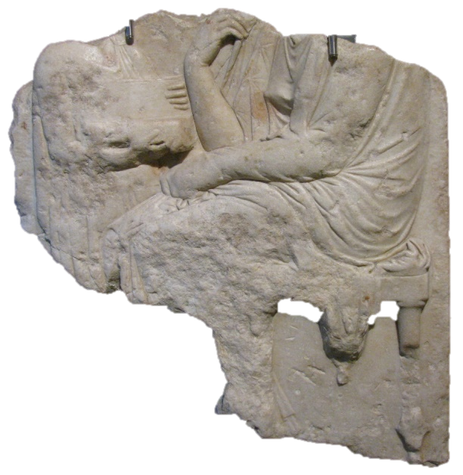
Anonymous ‘Originals’:
Greek Sculpture of the Classical Period in Roman Context
Gabriella Cirucci
gabriella.cirucci@sns.it
-----------------------------------------
Replicas in Roman Art: Redeeming the Copy?
Thursday 1st and Friday 2nd October 2015
Classical Art Research Centre, University of Oxford

Slide 2
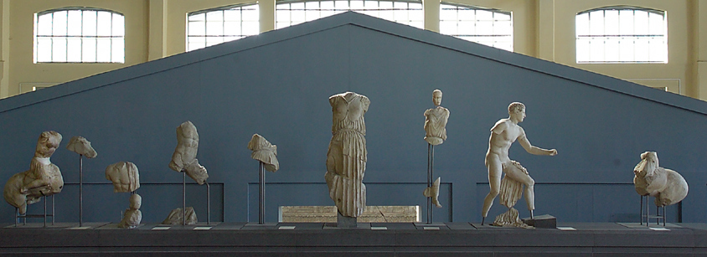
Greek ‘Originals’ in Rome
Roma. Musei Capitolini. Centrale Montemartini
Reconstruction of the pediment of the Temple of Apollo Sosianus as proposed by Eugenio La Rocca.
(From: La Rocca, E. Amazzonomachia. Le sculture frontonali del tempio di Apollo Sosiano. Roma 1985)
-----------------------------------------
Gabriella Cirucci, Anonymous ‘Originals’. Greek Sculpture of the Classical Period in Roman Context
Replicas in Roman Art: Redeeming the Copy? – CARC Workshop, University of Oxford

Slide 3
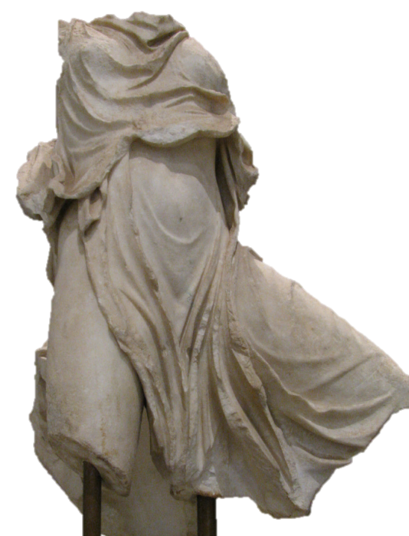

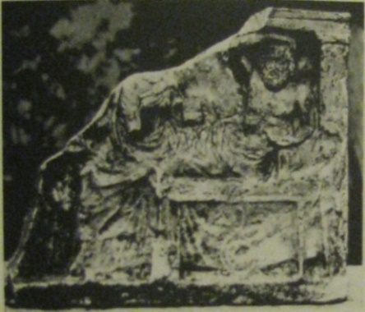
Anonymous ‘Originals’
«Palatine Aura». Roma. Museo Palatino. Inv. 124697
Roma. Musei Capitolini. Inv. 984
Banquet Relief.
Found near Casale San Paolo, Via Ardeatina.
-----------------------------------------
Replicas in Roman Art: Redeeming the Copy?
Classical Art Research Centre, University of Oxford

Slide 4
Greek ‘Originals’ in Rome
Roma. Musei Capitolini. Centrale Montemartini
Reconstruction of the pediment of the Temple of Apollo Sosianus as proposed by Eugenio La Rocca.
(From: La Rocca, E. Amazzonomachia. Le sculture frontonali del tempio di Apollo Sosiano. Roma 1985)
-----------------------------------------
Gabriella Cirucci, Anonymous ‘Originals’. Greek Sculpture of the Classical Period in Roman Context
Replicas in Roman Art: Redeeming the Copy? – CARC Workshop, University of Oxford

Slide 5
Anonymous ‘Originals’:
Greek Sculpture of the Classical Period in Roman Context
«Palatine Aura». Roma. Museo Palatino. Inv. 124697
Roma. Musei Capitolini. Inv. 984
Banquet Relief.
Found near Casale San Paolo, Via Ardeatina.
-----------------------------------------
Replicas in Roman Art: Redeeming the Copy?
Classical Art Research Centre, University of Oxford

Slide 6
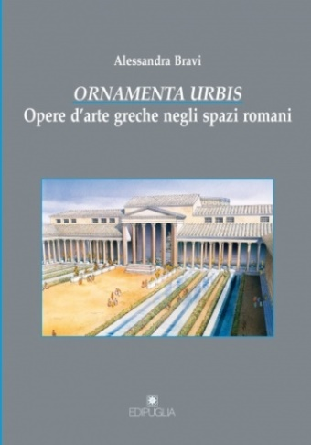
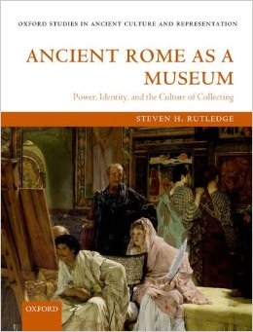
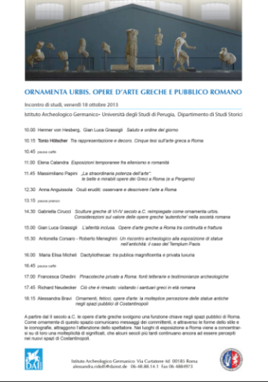
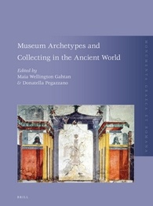
Introduction
-----------------------------------------
Greek ‘Originals’ in Rome
Some Recent Contributions to the Discussion
Bravi, A. Ornamenta Urbis. Opere d’arte greche negli spazi romani. Bari 2012
Rutledge, S. Ancient Rome as a Museum: Power, Identity, and the Culture of Collecting. Oxford 2012
Symposium: Ornamenta Urbis. Opere greche e pubblico romano. German Archaeological Institute (DAI) Rome. Roma 2013
Wellington Gahtan, M. and D. Pegazzano. Museum Archetypes and Collecting in the Ancient World. Leiden 2015
-----------------------------------------
Gabriella Cirucci, Anonymous ‘Originals’. Greek Sculpture of the Classical Period in Roman Context
Replicas in Roman Art: Redeeming the Copy? – CARC Workshop, University of Oxford

Slide 7
Greek ‘Originals’ in Museological Perspective
”With the public dedication of entire collections, the votive containers normally post-date the collected objects and were usually constructed (or re-constructed) for them so that their overall cultural meaning derives as much from the objects themselves and their dedicator, as from the architectural container erected to house them (…) Collections are valued as collections of selected great works and as such required their own appropriate public viewing spaces in the form of votive receptacles.”
(Wellington Gahtan, M. and D. Pegazzano. Museum Archetypes and Collecting in the Ancient World. Leiden 2015)
-----------------------------------------
Gabriella Cirucci, Anonymous ‘Originals’. Greek Sculpture of the Classical Period in Roman Context
Replicas in Roman Art: Redeeming the Copy? – CARC Workshop, University of Oxford

Slide 8
Greek ‘Originals’ in Museological Perspective
”With the public dedication of entire collections, the votive containers normally post-date the collected objects and were usually constructed (or re-constructed) for them so that their overall cultural meaning derives as much from the objects themselves and their dedicator, as from the architectural container erected to house them (…) Collections are valued as collections of selected great works and as such required their own appropriate public viewing spaces in the form of votive receptacles.”
(Wellington Gahtan, M. and D. Pegazzano. Museum Archetypes and Collecting in the Ancient World. Leiden 2015)
Greek ‘Originals’ in the ‘Semantic System’
”Alessandra Bravi starts from realizing that the Museum is basically a modern Institution, that cannot be anachronistically retrojected back upon antiquity. Instead, she shows the artworks transferred to Rome from Greece were displayed in specific places first and foremost for semantic reasons, on account of their subjects. There they served to visually convey political, social, cultural, or religious meaning to the spaces of public life.”
(Hölscher, T. “Preface.” In Bravi, A. Ornamenta Urbis. Opere d’arte greche negli spazi romani. Bari 2012)
-----------------------------------------
Gabriella Cirucci, Anonymous ‘Originals’. Greek Sculpture of the Classical Period in Roman Context
Replicas in Roman Art: Redeeming the Copy? – CARC Workshop, University of Oxford

Slide 9
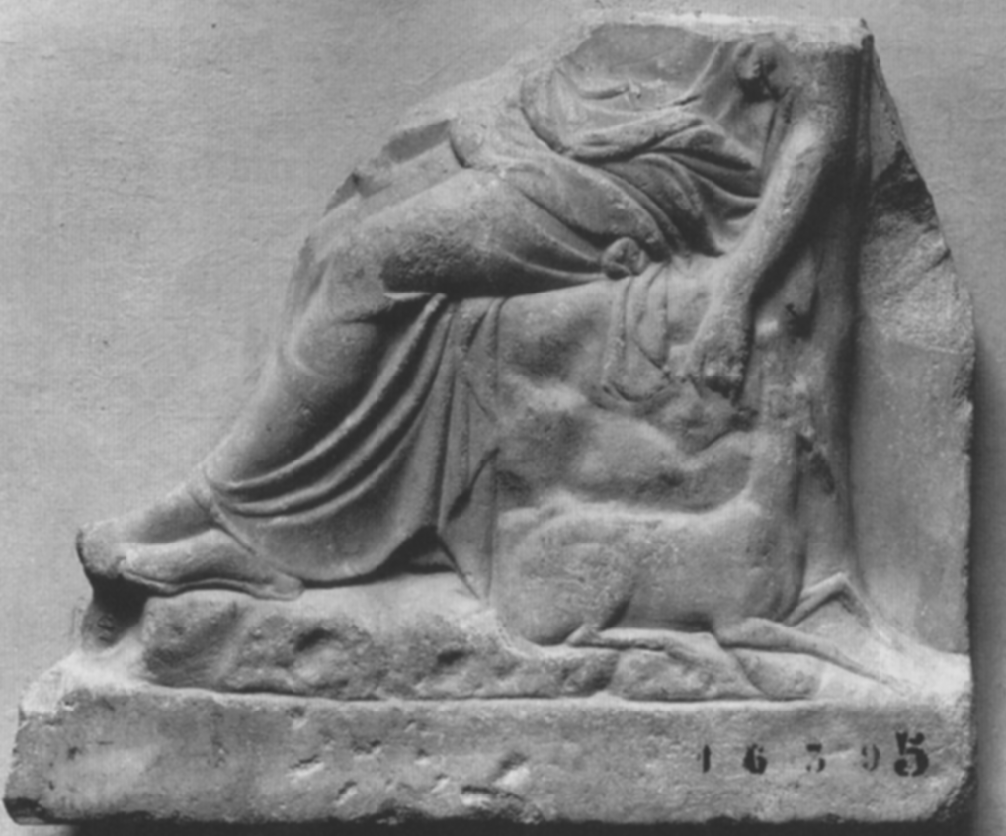
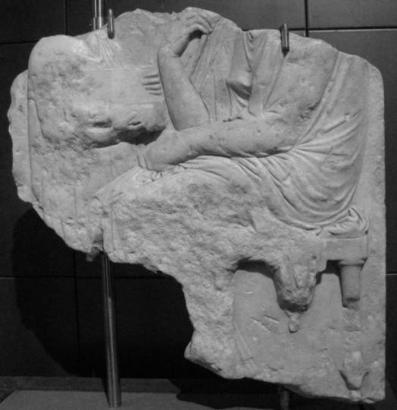
Greek ‘Originals’ in Roman Contexts:
Contrasting Interpretations
”Confirmation comes from the relatively large number of original Greek reliefs, especially votive and grave reliefs, that have been found in Rome and its surroundings and that must have served essentially to adorn fashionable residences. Their large mediocre quality already speaks against the idea that the high estimation of art was a primary factor (...) The primary factor was the adornment of urban and suburban villas with appropriate subject matter.”
(Hölscher, T. “Greek Styles and Greek Art in Augustan Rome. Issues of the Present versus Records of the Past” In Classical Pasts, edited by J. Porter, 2006)
”Ancient Roma possessed real open-air museums in the form of the imperial gardens (...) which were originally agricultural in function, but then given over to new uses as places to display collections of ancient and recent statues according to refined programs (…) These statues belonged to different styles and included original Greek Attic stelai, statues from Magna Graecia, and contemporary works and copies of famous works.”
(Maia Wellington Gahtan and Donatella Pegazzano 2015)
-----------------------------------------
Gabriella Cirucci, Anonymous ‘Originals’. Greek Sculpture of the Classical Period in Roman Context
Replicas in Roman Art: Redeeming the Copy? – CARC Workshop, University of Oxford

Slide 10

Anonymous ‘Originals’:
Greek Sculpture of the Classical Period in Roman Context
The Impact of Greek ‘Originals’ on Rome
-----------------------------------------
Replicas in Roman Art: Redeeming the Copy?
Classical Art Research Centre, University of Oxford

Slide 11
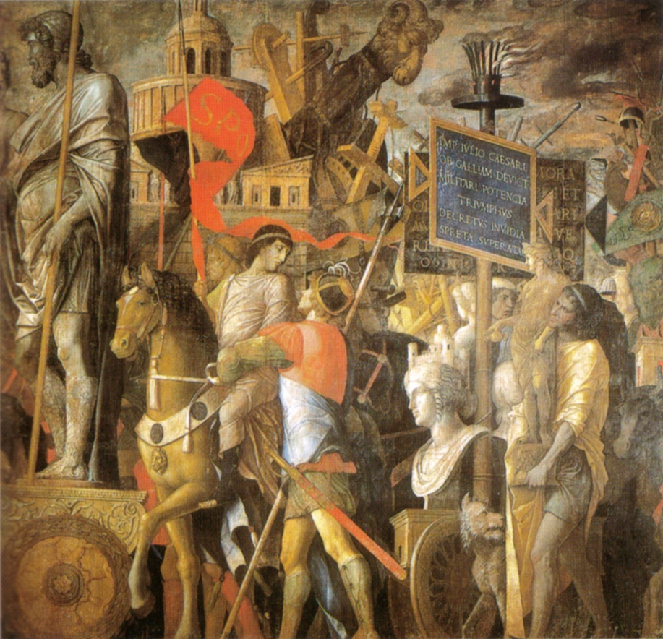
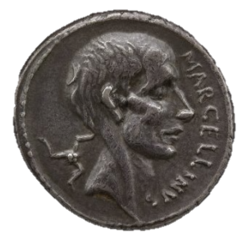
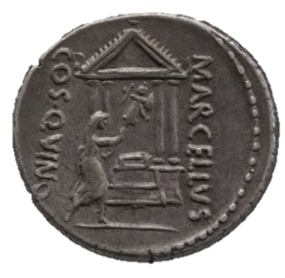
The Impact of Greek ‘Originals’ on Rome
(Plutarch. Marcellus. 21,5)
(They blamed Marcellus) that he made the people idle and full of glib talk about art and artists, so that they spent a great part of the day in such clever disputation.
Silver denarius celebrating the victories of Marcellus
Minted in Rome, 50BC. London, British Museum, Dep. Coins & Medals, Reg. no. 1867.0101.1212.
Andrea Mantegna, The Triumphs of Caesar
Royal Collection Trust / © HM Queen Elizabeth II 2015
-----------------------------------------
Gabriella Cirucci, Anonymous ‘Originals’. Greek Sculpture of the Classical Period in Roman Context
Replicas in Roman Art: Redeeming the Copy? – CARC Workshop, University of Oxford

Slide 12
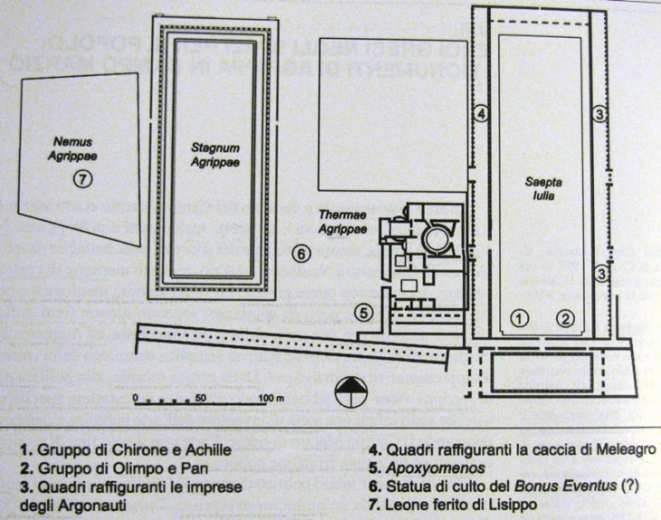
The Impact of Greek ‘Originals’ on Rome
Greek ‘Originals’ as Ornamenta Urbis
“Extat certe eius oratio magnifica et maximo civium digna de tabulis omnibus signisque publicandis, quod fieri satius fuisset quam in villarum exilia pelli”
(Pliny. Natural History. 35,26)
“There is preserved a speech of Agrippa, lofty in tone and worthy of the greatest of the citizens, on the question of making all pictures and statues national property, a procedure which would have been preferable to banishing them to country houses.”
Works of art in the monuments of Agrippa
(from A. Bravi, Ornamenta Urbis, Bari 2012)
-----------------------------------------
Gabriella Cirucci, Anonymous ‘Originals’. Greek Sculpture of the Classical Period in Roman Context
Replicas in Roman Art: Redeeming the Copy? – CARC Workshop, University of Oxford

Slide 13
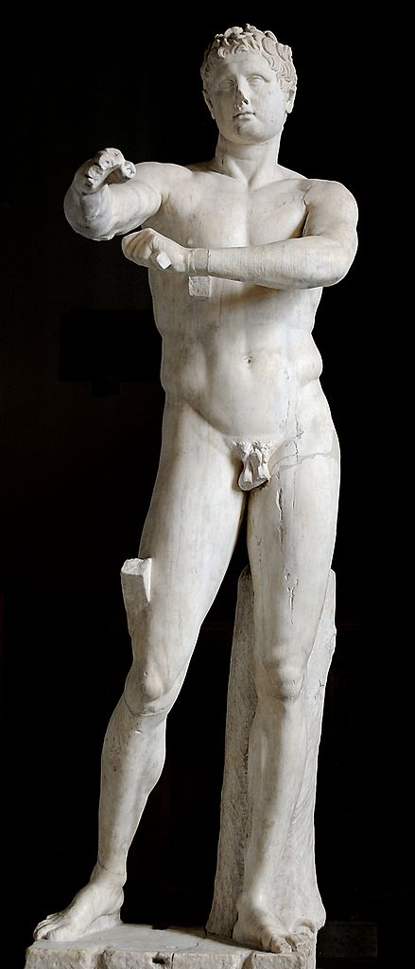

Lost Masterpieces
Lysippus (made) the Apoxyomenos which Marcus Agrippa gave to be set up in front of his Baths and of which the emperor Tiberius was remarkably fond. (Pliny. Natural History. 34, 61)
Anonymous ‘Originals’
Campus Martius. Monuments of Agrippa
Marble statue of a Body-scraper
commonly identified as a copy of the Apoxyomenos by Lysippus.
Vatican Museums. Museo Pio Clementino. Inv. 1185
«Palatine Aura». Roma. Museo Palatino. Inv. 124697
Greek Banquet Relief.
Found near Casale San Paolo, Via Ardeatina.
-----------------------------------------
Gabriella Cirucci, Anonymous ‘Originals’. Greek Sculpture of the Classical Period in Roman Context
Replicas in Roman Art: Redeeming the Copy? – CARC Workshop, University of Oxford

Slide 14

Re-staging Greek Funerary Sculptures and Reliefs:
A Case-study
-----------------------------------------
Gabriella Cirucci, Anonymous ‘Originals’. Greek Sculpture of the Classical Period in Roman Context
Replicas in Roman Art: Redeeming the Copy? – CARC Workshop, University of Oxford

Slide 15
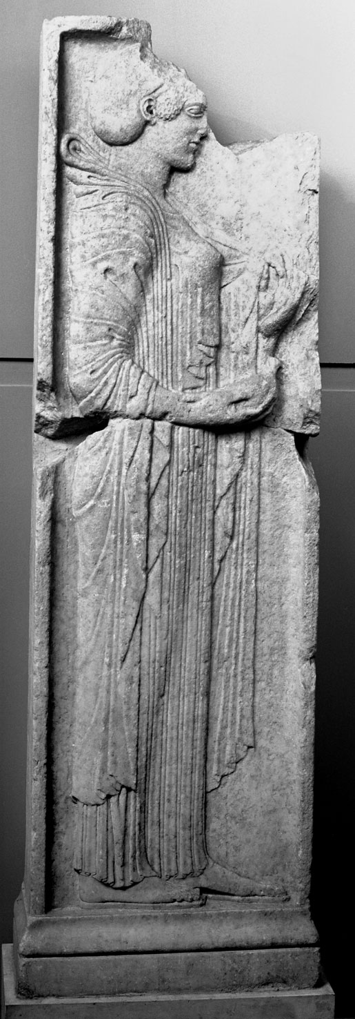
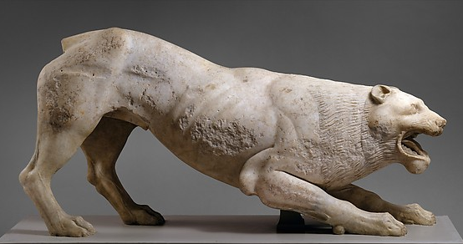
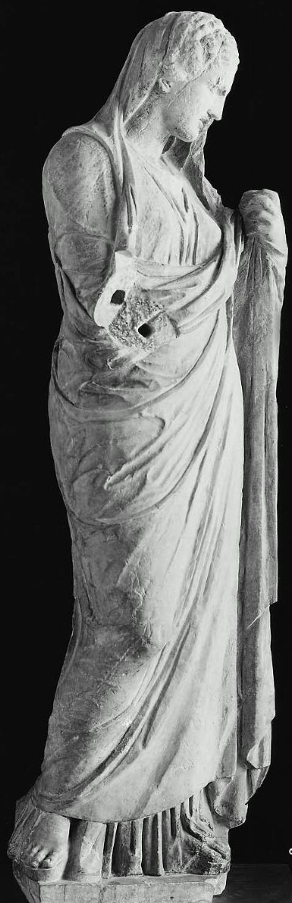
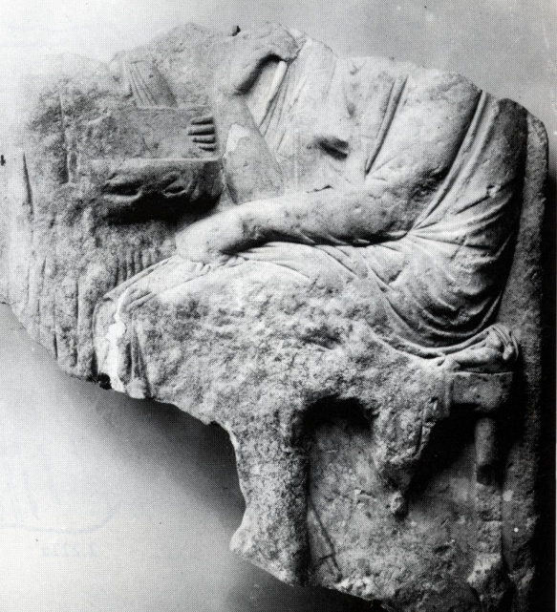
Re-staging Greek Funerary Sculptures and Reliefs:
New York. Metropolitan Museum. Inv. 09.221.3.
H. 79.4 cm; L. 161.3 cm.
First half of the 5th century B.C.
Roma. Museo Barracco. Inv. 73. H. 73 cm; L. 55 cm.
ca 525-510 B.C.
Roma. Musei Capitolini.
Inv. 987. H. 173.5 cm;
L. 47.5 cm . ca 490-480 B.C.
Roma. Musei Capitolini. Inv. 984
H. 78 cm; L. 80 cm.
Beginning of the 4th century B.C.
Boston. Museum of
Fine Arts. Inv. 98.642.
H. 201 cm. ca 325-10 B.C.
-----------------------------------------
Gabriella Cirucci, Anonymous ‘Originals’. Greek Sculpture of the Classical Period in Roman Context
Replicas in Roman Art: Redeeming the Copy? – CARC Workshop, University of Oxford

Slide 16
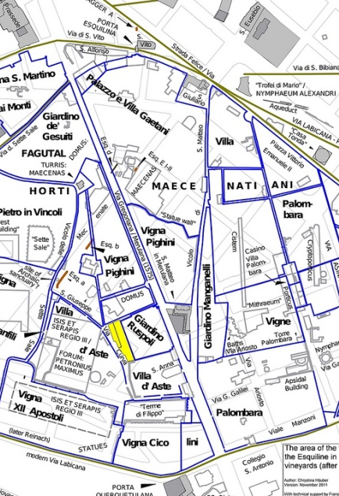
From Documented Excavations
A
A
The Esquiline hill (C. Häuber )
Roma. Musei Capitolini. Inv. 987.
Excavated in 1882 inside Villa Palombara on the Esquiline hill. Published by Ghirardini in BCom 1883
-----------------------------------------
Gabriella Cirucci, Anonymous ‘Originals’. Greek Sculpture of the Classical Period in Roman Context
Replicas in Roman Art: Redeeming the Copy? – CARC Workshop, University of Oxford

Slide 17
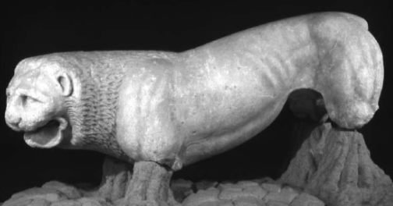
From Documented Excavations
A
B
A
The Esquiline hill (C. Häuber )
Roma. Musei Capitolini. Inv. 987.
Excavated in 1882 inside Villa Palombara on the Esquiline hill. Published by Ghirardini in BCom 1883
B
Firenze. Archaeological Museum. Inv. 13832.
Found in the 16th century in the «Terme di Filippo» on the Esquiline hill. Designed by Pierre Jacques, Album, fol. 79r and described by Ulisse Aldrovandi, Delle statue antiche.., Roma 1562.
-----------------------------------------
Gabriella Cirucci, Anonymous ‘Originals’. Greek Sculpture of the Classical Period in Roman Context
Replicas in Roman Art: Redeeming the Copy? – CARC Workshop, University of Oxford

Slide 18
From Documented Excavations
Alleged Provenance
A
New York. Metropolitan Museum. Inv. 09.221.3.
Said to have been found in Trastevere, near
Porta Portese
B
A
The Esquiline hill (C. Häuber )
Roma. Musei Capitolini. Inv. 987.
Excavated in 1882 inside Villa Palombara on the Esquiline hill. Published by Ghirardini in BCom 1883
B
Firenze. Archaeological Museum. Inv. 13832.
Found in the 16th century in the «Terme di Filippo» on the Esquiline hill. Designed by Pierre Jacques, Album, fol. 79r and described by Ulisse Aldrovandi, Delle statue antiche.., Roma 1562.
-----------------------------------------
Gabriella Cirucci, Anonymous ‘Originals’. Greek Sculpture of the Classical Period in Roman Context
Replicas in Roman Art: Redeeming the Copy? – CARC Workshop, University of Oxford

Slide 19
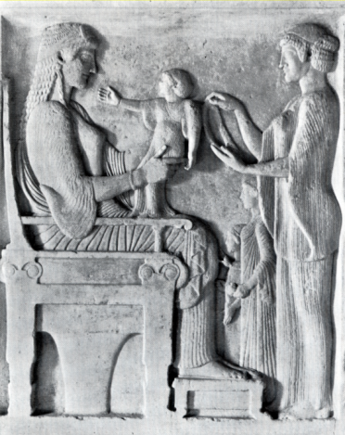
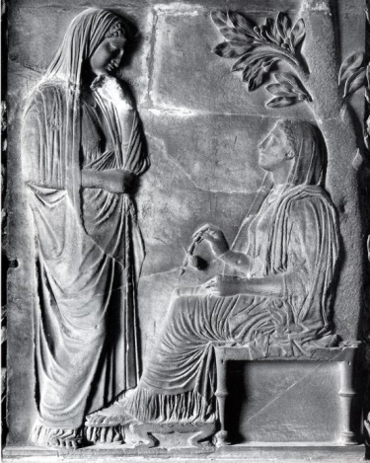
From Documented Excavations
Alleged Provenance
A
New York. Metropolitan Museum. Inv. 09.221.3.
Said to have been found in Trastevere, near
Porta Portese
B
In Roman Historical Collections
A
The Esquiline hill (C. Häuber )
Roma. Musei Capitolini. Inv. 987.
Excavated in 1882 inside Villa Palombara on the Esquiline hill. Published by Ghirardini in BCom 1883
B
Firenze. Archaeological Museum. Inv. 13832.
Found in the 16th century in the «Terme di Filippo» on the Esquiline hill. Designed by Pierre Jacques, Album, fol. 79r and described by Ulisse Aldrovandi, Delle statue antiche.., Roma 1562.
Roma. Villa Albani.
Inv. 980.
Roma. Palazzo Barberini.
-----------------------------------------
Gabriella Cirucci, Anonymous ‘Originals’. Greek Sculpture of the Classical Period in Roman Context
Replicas in Roman Art: Redeeming the Copy? – CARC Workshop, University of Oxford

Slide 20
Re-staging Greek Funerary Sculptures:
Roma. Museo Barracco. Inv. 73. H. 73 cm; L. 55 cm.
ca 525-510 B.C.
Roma. Musei Capitolini.
Inv. 987. H. 173.5 cm;
L. 47.5 cm . ca 490-480 B.C.
Roma. Musei Capitolini. Inv. 984
H. 78 cm; L. 80 cm.
Beginning of the 4th century B.C.
Musei Vaticani. Museo Gregoriano Profano Inv. 559
H. 206 cm
-----------------------------------------
Gabriella Cirucci, Anonymous ‘Originals’. Greek Sculpture of the Classical Period in Roman Context
Replicas in Roman Art: Redeeming the Copy? – CARC Workshop, University of Oxford

Slide 21
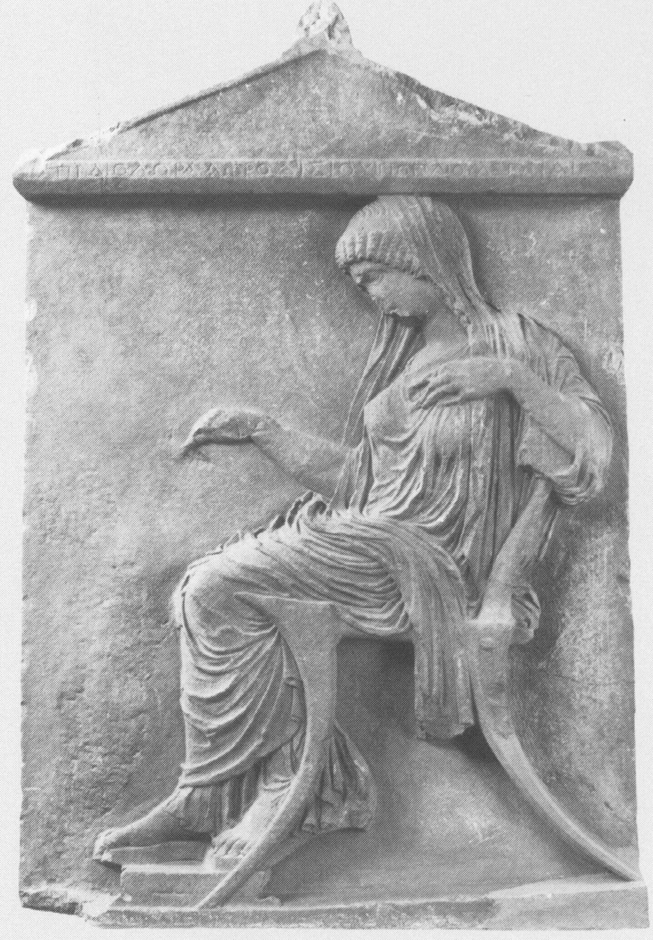
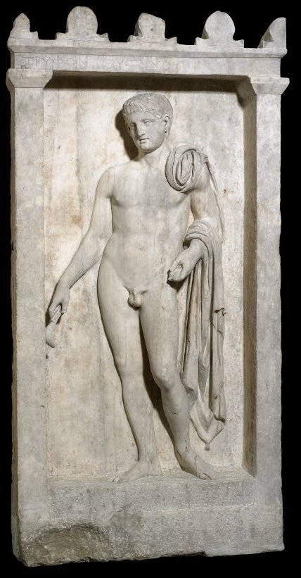
Athens. National Museum. Inv. 818.. Stele of the late 5th century B.C. reused in the Roman period as a gravestone for Diodora,
British Museum. Inv. 1839,1102.1 Gravestone of Tryphon
-----------------------------------------
Gabriella Cirucci, Anonymous ‘Originals’. Greek Sculpture of the Classical Period in Roman Context
Replicas in Roman Art: Redeeming the Copy? – CARC Workshop, University of Oxford

Slide 22
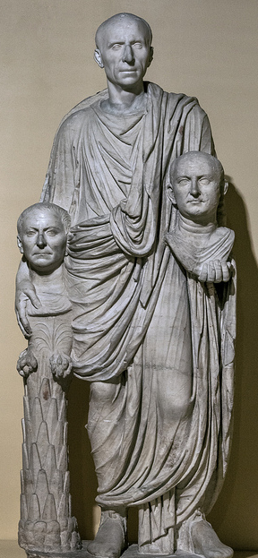
Athens. National Museum. Inv. 818.. Stele of the late 5th century B.C. reused in the Roman period as a gravestone for Diodora,
British Museum. Inv. 1839,1102.1 Gravestone of Tryphon
Roma. Centrale Montemartini. Inv. 2392. «Barberini Togatus». (Head not belonging) End of the 1st century B.C.
-----------------------------------------
Gabriella Cirucci, Anonymous ‘Originals’. Greek Sculpture of the Classical Period in Roman Context
Replicas in Roman Art: Redeeming the Copy? – CARC Workshop, University of Oxford

Slide 23
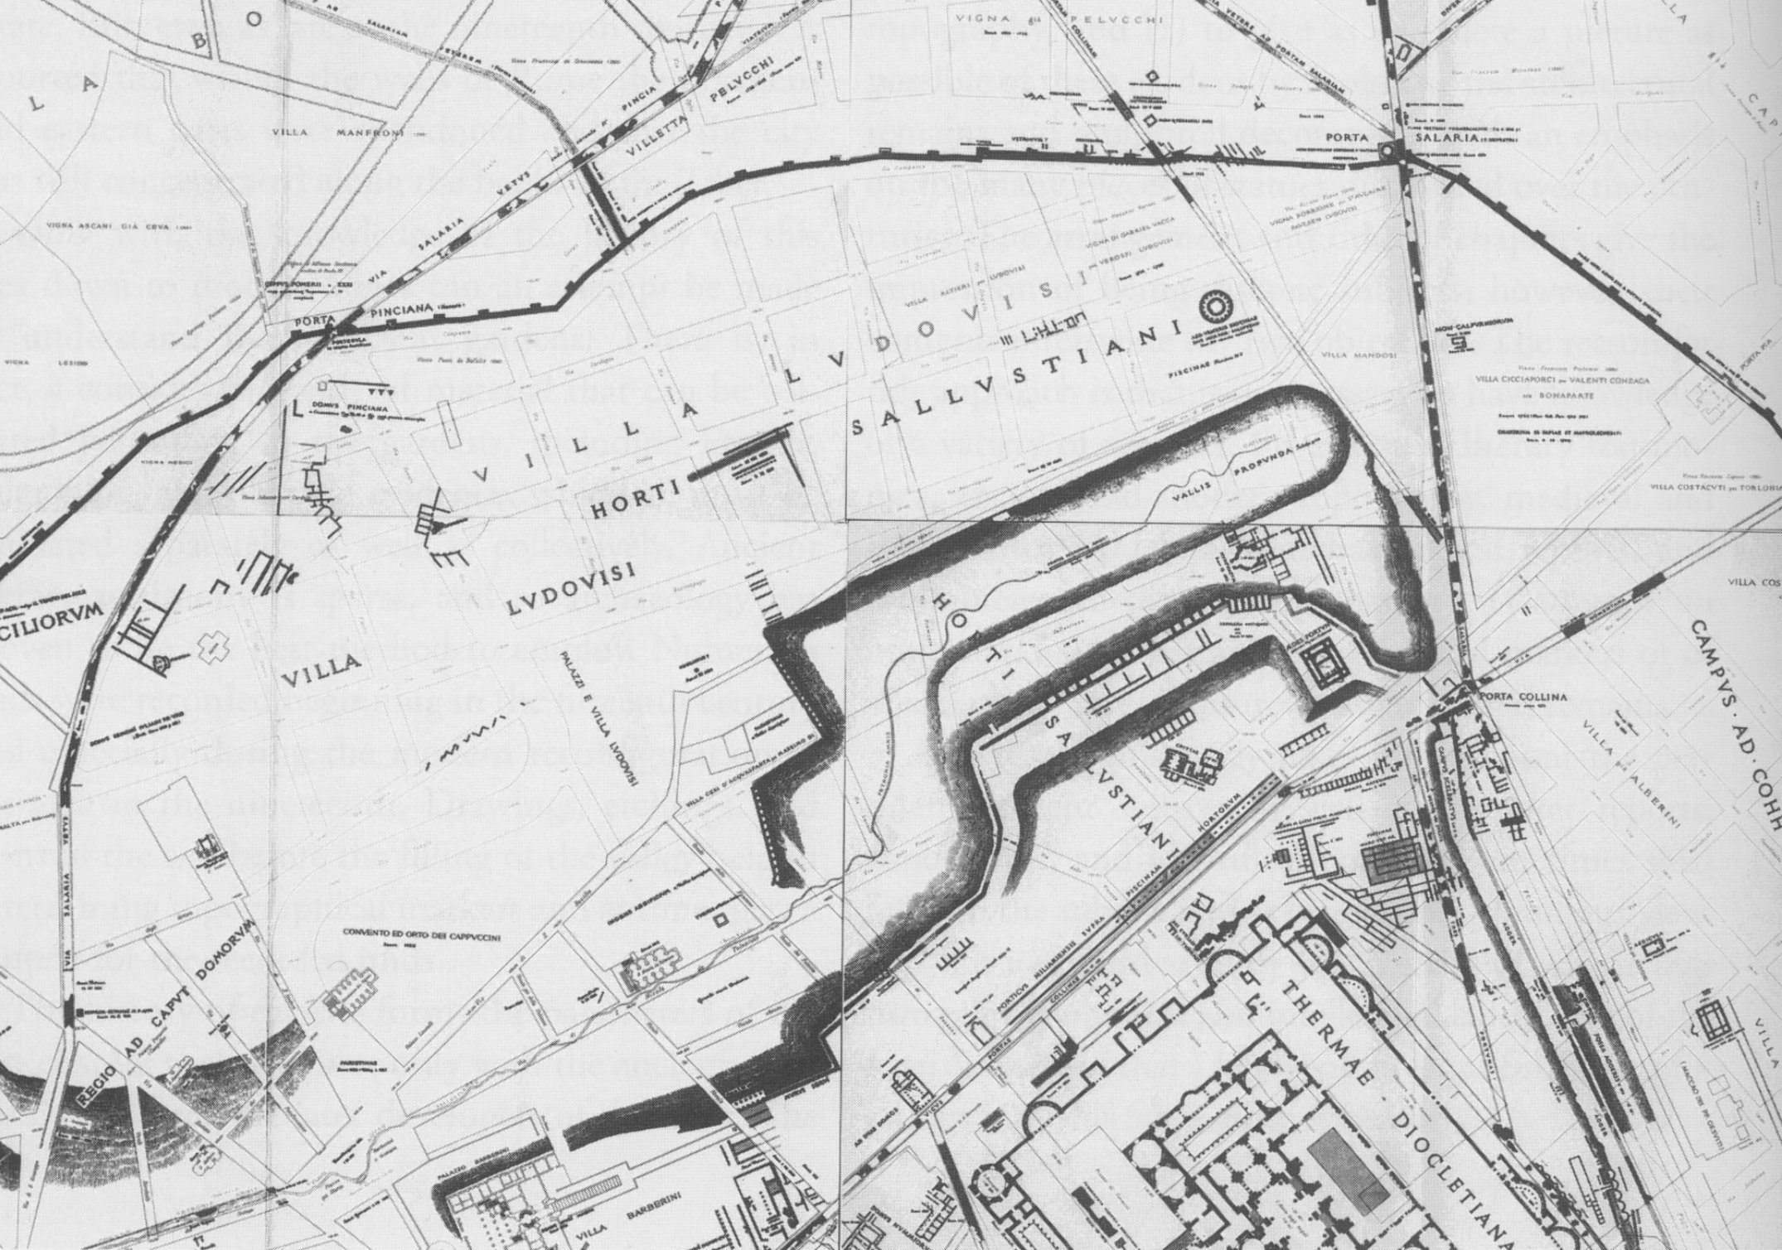

A
A
The horti Sallustiani near the porta Collina
Roma. Museo Barracco. Inv. 73. ca 525-510 B.C.
C
C
Roma. Musei Capitolini. Inv. 987. ca 490-480 B.C.
B
B
Firenze. Archaeological Museum. Inv. 13832.
End of the 5th century B.C.
Horti on the Esquiline hill (C. Häuber )
-----------------------------------------
Gabriella Cirucci, Anonymous ‘Originals’. Greek Sculpture of the Classical Period in Roman Context
Replicas in Roman Art: Redeeming the Copy? – CARC Workshop, University of Oxford

Slide 24
Re-staging Greek Funerary Sculptures and Reliefs:
”At unde est ista inventa Libertas? quaesivi enim diligenter. Tanagraea quaedam meretrix fuisse dicitur. Eius non longe a Tanagra simulacrum e marmore in sepulcro positum fuit. Hoc quidam homo nobilis, non alienus ab hoc religioso Libertatis sacerdote, ad ornatum aedilitatis suae deportavit”
(Cicero, De Domo sua, 111)
“But from whence was that Liberty brought? for I sought for her diligently. She is said to have been a prostitute at Tanagra. At no great distance from Tanagra a marble image of her was placed on her tomb. A certain man of noble birth [Appius, brother of Clodius], not altogether unconnected with this holy priest of Liberty, carried off this statue to decorate his aedileship”
-----------------------------------------
Gabriella Cirucci, Anonymous ‘Originals’. Greek Sculpture of the Classical Period in Roman Context
Replicas in Roman Art: Redeeming the Copy? – CARC Workshop, University of Oxford

Slide 25
Re-staging Greek Funerary Sculptures and Reliefs:
-----------------------------------------
Vatican Museums.
Museo Gregoriano Profano. Inv. 559
H. 206 cm (Upper fragment: H. 139,5 cm; L. 65 cm;
Lower fragment: H. 66,5 cm; L. 70,5 cm)
-----------------------------------------
Gabriella Cirucci, Anonymous ‘Originals’. Greek Sculpture of the Classical Period in Roman Context
Replicas in Roman Art: Redeeming the Copy? – CARC Workshop, University of Oxford

Slide 26
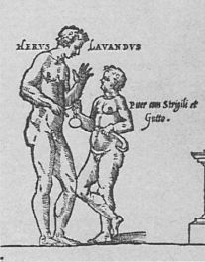
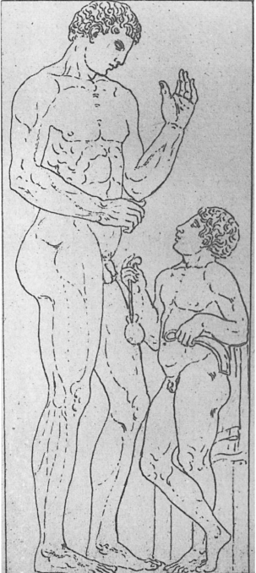
Re-staging Greek Funerary Sculptures and Reliefs:
-----------------------------------------
1.
Vatican Museums.
Museo Gregoriano Profano. Inv. 559
H. 206 cm (Upper fragment: H. 139,5 cm; L. 65 cm;
Lower fragment: H. 66,5 cm; L. 70,5 cm)
2.
Marco Fabio Calvo, Antiquae urbis Romae
cum regionibus Simulachrum, Roma 1527
2. Pierre Jacques, Album (1572-1577)
-----------------------------------------
Gabriella Cirucci, Anonymous ‘Originals’. Greek Sculpture of the Classical Period in Roman Context
Replicas in Roman Art: Redeeming the Copy? – CARC Workshop, University of Oxford

Slide 27
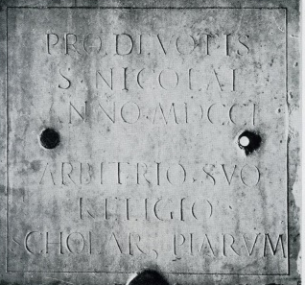
Re-staging Greek Funerary Sculptures and Reliefs:
-----------------------------------------
Inscription engraved on the back of the lower fragment (1701)
1.
Vatican Museums.
Museo Gregoriano Profano. Inv. 559
H. 206 cm (Upper fragment: H. 139,5 cm; L. 65 cm;
Lower fragment: H. 66,5 cm; L. 70,5 cm)
2.
Marco Fabio Calvo, Antiquae urbis Romae
cum regionibus Simulachrum, Roma 1527
2. Pierre Jacques, Album (1572-1577)
-----------------------------------------
Gabriella Cirucci, Anonymous ‘Originals’. Greek Sculpture of the Classical Period in Roman Context
Replicas in Roman Art: Redeeming the Copy? – CARC Workshop, University of Oxford

Slide 28
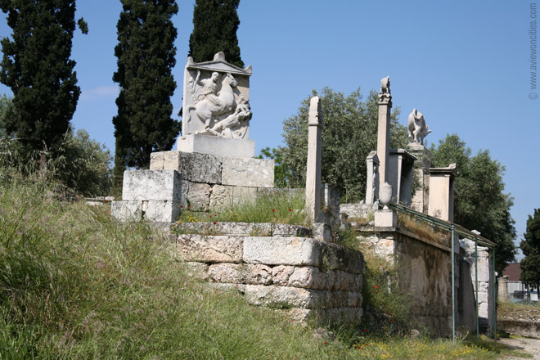
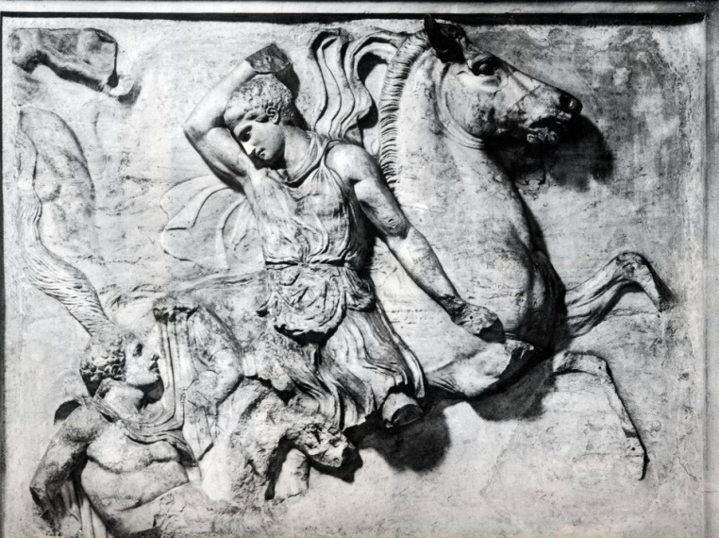
Funerary Reliefs from the area of the Esquiline Gardens
A refined evocation of the Athenian Kerameikos?
after Bell, M., III, 1998: "Le stele greche dell'Esquilino e il cimitero di Mecenate,” in M. Cima and E. La Rocca, eds., Horti Romani, Roma 1998
5
1.
1.
3.
4.
2.
2.
3.
4.
5.
-----------------------------------------
Gabriella Cirucci, Anonymous ‘Originals’. Greek Sculpture of the Classical Period in Roman Context
Replicas in Roman Art: Redeeming the Copy? – CARC Workshop, University of Oxford

Slide 29
Re-staging Anonymous ‘Originals’
New York. Metropolitan Museum. Inv. 09.221.3.
H. 79.4 cm; L. 161.3 cm.
First half of the 5th century B.C.
Roma. Museo Barracco. Inv. 73. H. 73 cm; L. 55 cm.
ca 525-510 B.C.
Roma. Musei Capitolini.
Inv. 987. H. 173.5 cm;
L. 47.5 cm . ca 490-480 B.C.
Roma. Musei Capitolini. Inv. 984
H. 78 cm; L. 80 cm.
Beginning of the 4th century B.C.
Boston. Museum of
Fine Arts. Inv. 98.642.
H. 201 cm. ca 325-10 B.C.
-----------------------------------------
Gabriella Cirucci, Anonymous ‘Originals’. Greek Sculpture of the Classical Period in Roman Context
Replicas in Roman Art: Redeeming the Copy? – CARC Workshop, University of Oxford

Slide 30
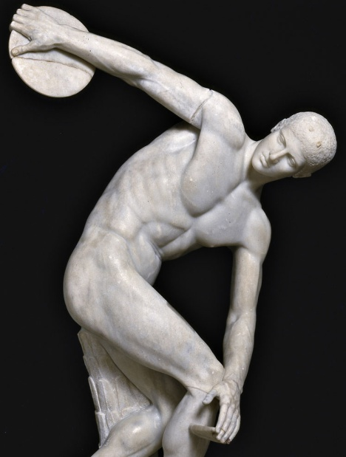
Re-staging Anonymous ‘Originals’
-----------------------------------------
Gabriella Cirucci, Anonymous ‘Originals’. Greek Sculpture of the Classical Period in Roman Context
Replicas in Roman Art: Redeeming the Copy? – CARC Workshop, University of Oxford

Slide 31
Anonymous ‘Originals’:
Greek Sculpture of the Classical Period in Roman Context
Gabriella Cirucci
gabriella.cirucci@sns.it
-----------------------------------------
Replicas in Roman Art: Redeeming the Copy?
Thursday 1st and Friday 2nd October 2015
Classical Art Research Centre, University of Oxford

